Slide 1

Tableau Desktop

Slide 2
Introduction
Tableau is an easy to use business intelligence software. It makes data visualization, data analytics, and reporting as easy as dragging and dropping. Anyone can learn to use Tableau without having a prior programming experience. Tableau can combine data from various
data sources such as spreadsheets, databases, cloud data, and even big data- all into one program to perform dynamic analysis.
Why Tableau
Whether it’s small or large, profitable or non-profit, every organization needs to analyze their data for optimal decision making. Analyzing data has never been easier with traditional business intelligence tools.
Here are some of the advantages of using Tableau over the traditional BI tools:
Traditional Method | Tableau
Requires specific programming skills | No programming skills required
Focused on only one type of database | Combines different types of database spreadsheets, databases, cloud data, and even big data such as Hadoop
Time consuming | Time saving
Decision makers have to ask the IT people to retrieve any information from the database | Decision makers can directly use the dashboard to retrieve any information from the database
Largely depends on Query languages | Query is done behind the scene
Combining different types of database is difficult | Different types of databases can be combined easily
Not every business intelligence tool offers interactive dashboard | Interactive dashboard is easy to build and it makes data visualization quick and efficient
Comparatively expensive | Comparatively affordable
Mostly designed for large businesses | Perfect BI solution for small, medium, and large businesses, and even for non-profits
Tableau is the next generation’s business intelligence software that brings traditional complex analytics to the end user in a
desktop environment with dynamic and faster performance.

Slide 3
Tableau Desktop Role
Tableau Desktop is common for everyone. The Tableau Desktop contains different types of development tools, which helps to perform development activities. From creating reports, charts, formatting them, putting them together as a dashboard all the work is done on Tableau Desktop.
Tableau Server can be collaborated for any organization. Tableau Server is said to be a sharing tool, which helps to share and create data visualization for any organizations and fully secured. In major, it safely distribute interactive data in website or web. Creating new workbooks and dashboards are restricted in Tableau Server. It is used as an elevated concert data sources for desktop users. Tableau Server is highly secured for visualizing data.
Tableau Online an alternative to Tableau Server in which the servers are on Cloud. Servers are not maintained by users but by Tableau teams.
Tableau Reader is a free application that lets anyone view and interact with Tableau packaged workbooks. These packaged workbooks are created using Tableau Desktop, and are self-contained documents that combine the data and the Tableau visual analysis into a single file
Tableau Mobile is the fastest, most delightful way to keep your data at your fingertips. Go from question to insight in just a few taps with Tableau Mobile's streamlined experience. Get hands-on with your data from anywhere
Tableau Public is a new platform for data stories. on the web. For free. Tableau Public is for anyone who wants to tell interactive data stories on the web. It's delivered as a service so you can be up and running right now.

Slide 4
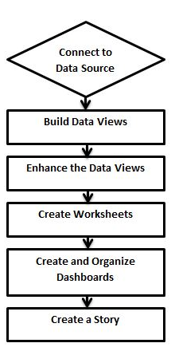
Tableau Design Flow
As Tableau help us analyze a lots of data over many time periods, dimensions and measures, it needs a very meticulous planning to create a good dashboard or story. hence it is important to know the approach to design a good dashboards. Like any other field of human endeavor, there are many best practices to be followed to create good worksheets and dashboards.
Though the final outcome expected from a Tableau project is ideally a dashboard with story, there are many intermediate steps which need to be completed to reach this goal. Below is a flow of design steps that should be ideally followed to create effective dashboards.
Connect to Data Source
Tableau connects to all popular data sources. It has inbuilt connectors which take care of establishing the connection once the connection parameters are supplied. be it Simple text files, Relational sources, No Sql sources or Cloud data bases, tableau connects to nearly every data source.
Build Data Views
After connecting to a data source, you get all the column and data available in the Tableau environment. You classify them as dimensions, measures and create any hierarchy required. Using these you build views which are traditionally known as Reports. Tableau provides easy drag and drop feature to build views.
Enhance the Views
The views created above needs to be enhanced further by use of filters, aggregations, Labeling of Axes,
Formatting of colors and borders etc.
Create Worksheets
We create different worksheets to create different views on the same data or different data.
Create and Organize Dashboards
Dashboards contain multiple worksheets which are linked it.
So the action in any of the worksheet can change the result in the dashboard accordingly.
Create a Story
A story is a sheet that contains a sequence of worksheets or dashboards that work together to convey information.
You can create stories to show how facts are connected, provide context, demonstrate how decisions relate to outcomes, or simply make a compelling case

Slide 5
Tableau File Types
The result of data analysis in Tableau can be saved in various formats to be saved and distributed. These various formats are referred as different file types and they are identified by different extensions. Their formats depend on how they are produced and for what purpose they are used. They are all stored as XML files which can be opened and edited.
The description of each of the file type and their usage is as follows:
File Type | File Extension | Purpose
Tableau Workbook | .twb | It contains information on each sheet and dashboard that is present in a workbook. It has the details of the fields which are used in each view and the formula applied to the aggregation of the measures. It also has the formatting and styles applied. It also contains the data source connection information and any metadata information created for that connection.
Tableau Packaged Workbook | .twbx | This file format contains the details of workbook as well as the local data that is used in the analysis. Its purpose is to be share with other Tableau desktop or Tableau reader users assuming it does not need data from the server.
Tableau Data source | .tds | The details of the connection used to create the tableau report are stored in this file. In the connection details it stores the source type(excel/relational/sap etc.) as well as the data types of the columns.
Tableau Packaged Data source | .tdsx | This file is similar to the .tds file with the addition of data along with the connection details.
Tableau Data Extract | .tde | This file contains the data used in a .twb file in a highly compressed columnar data format. This helps in storage optimization. It also saves the aggregated calculations that are applied in the analysis. This file should be refreshed to get the updated data form the source.
Tableau Bookmark | .tbm | These files contain a single worksheet that is shared easily to be pasted into other workbooks.
Tableau Preferences | .tps | This file stores the colour preference used across all the workbooks. It is mainly used for consistent look and feel across the users.

Slide 6
Application Terminology
As a powerful data visualization tool, Tableau has many unique terms and definitions. We need to get acquainted with their meaning before we start using the features in Tableau. The below list of terms is comprehensive and explain the terms most frequently used.
Term | Description
alias | An alternative name that you can assign to a field or to a dimension member.
bin | A user-defined grouping of measures in the data source.
bookmark | A .tbm file in the Bookmarks folder in the Tableau repository that contains a single worksheet. Much like web browser bookmarks, .tbm files are a convenient way to quickly display different analyses.
calculated field | A new field that you create by using a formula to modify the existing fields in your data source.
crosstab | A text table view. Use text tables to display the numbers associated with dimension members.
dashboard | A combination of several views arranged on a single page. Use dashboards to compare and monitor a variety of data simultaneously.
data pane | A pane on the left side of the workbook that displays the fields of the data sources to which Tableau is connected. The fields are divided into dimensions and measures. The Data pane also displays custom fields such as calculations, binned fields, and groups. You build views of your data by dragging fields from the Data pane onto the various shelves that are a part of every worksheet.
data Source page | A page where you can set up your data source. The Data Source page generally consists of four main areas: left pane, join area, preview area, and metadata area.
dimension | A field of categorical data. Dimensions typically hold discrete data such as hierarchies and members that cannot be aggregated. Examples of dimensions include dates, customer names, and customer segments.
extract | A saved subset of a data source that you can use to improve performance and analyze offline. You can create an extract by defining filters and limits that include the data you want in the extract.
filters shelf | A shelf on the left of the workbook that you can use to exclude data from a view by filtering it using measures and dimensions.
format pane | A pane that contains formatting settings that control the entire worksheet, as well as individual fields in the view. When open, the Format pane appears on the left side of the workbook.
level of detail (LOD) expression | A syntax that supports aggregation at dimensionalities other than the view level. With level of detail expressions, you can attach one or more dimensions to any aggregate expression.
marks | A part of the view that visually represents one or more rows in a data source. A mark can be, for example, a bar, line, or square. You can control the type, color, and size of marks.
marks card | A card to the left of the view where you can drag fields to control mark properties such as type, color, size, shape, label, tooltip, and detail.
pages shelf | A shelf to the left of the view that you can use to split a view into a sequence of pages based on the members and values in a discrete or continuous field. Adding a field to the Pages shelf is like adding a field to the Rows shelf, except that a new page is created for each new row.
rows shelf | A shelf at the top of the workbook that you can use to create the rows of a data table. The shelf accepts any number of dimensions and measures. When you place a dimension on the Rows shelf, Tableaus creates headers for the members of that dimension. When you place a measure on the Rows shelf, Tableau creates quantitative axis for that measure.
shelves | Named areas to the left and top of the view. You build views by placing fields onto the shelves. Some shelves are available only when you select certain mark types. For example, the Shape shelf is available only when you select the Shape mark type.
workbook | A file with a .twb extension that contains one or more worksheets (and possibly also dashboards and stories).
worksheet | A sheet where you build views of your data by dragging fields onto shelves.

Slide 7
Visual Cues and Icons
Tableau provides many visual cues to help you evaluate the type of data that’s displayed in the Data pane and the state of a data view.
Data sources in the Data pane
The following table explains each of the icons used to describe the type of data sources in the Data pane. Each icon in the table can be modified by one of two indicators

Slide 8
Visual Cues and Icons
Tableau provides many visual cues to help you evaluate the type of data that’s displayed in the Data pane and the state of a data view.

Slide 9
Visual Cues and Icons

Slide 10
Visual Cues and Icons

Slide 11
Visual Cues and Icons

Slide 12
Visual Cues and Icons

Slide 13
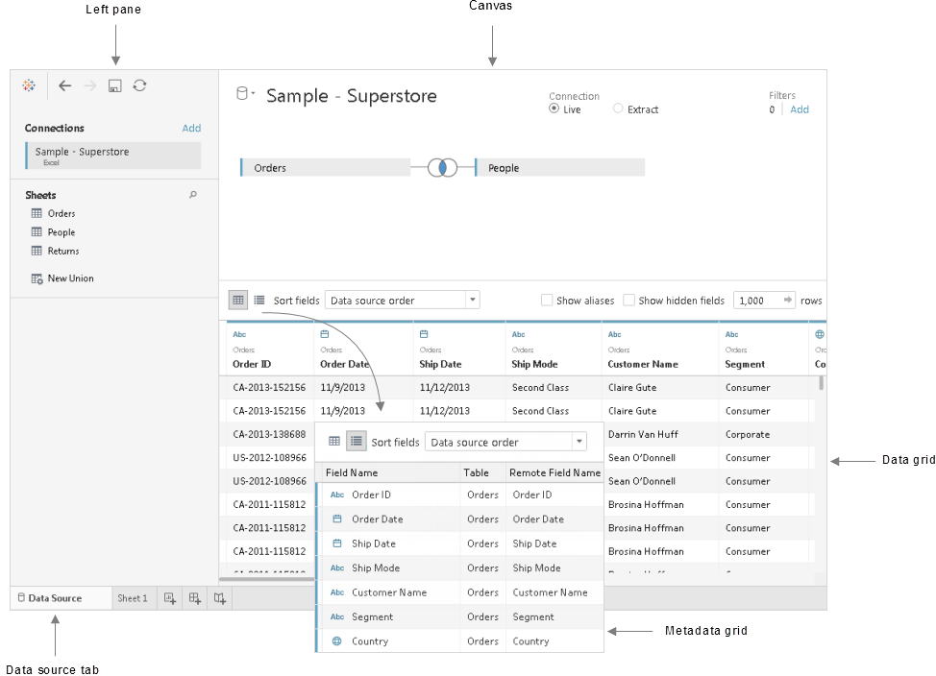
Datasource Page
Before or during your analysis, you may want to make changes to the Tableau data source. You can do that on the data source page. Tableau takes you to the data source page after you establish the initial connection to your data. You can also access the data source page by clicking the Data Source tab from any location in the workbook.
Although the look of the page and the options available vary depending on the type of data that you are connected to, the data source page generally consists of four main areas: left pane, canvas, data grid, and metadata grid.
Left pane
The left pane of the data source page displays details about your data, that is the data that Tableau Desktop is connected to. For file-based data, the left pane might display the file name and the worksheets in the file. For relational-based data, the left pane might display the server, the database or schema, and the tables in the database.
You can also use the left pane to add more connections to the data source to create cross-database joins.
The left pane does not display for cube (multidimensional) data.

Slide 14
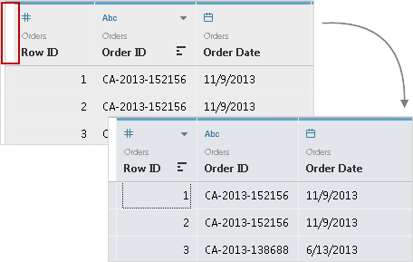
Datasource Page
Canvas
When connected to most relational and file-based data, you can drag one or more tables to the canvas area to set up your Tableau data source.
When connected to cube data, the top of the data source page displays the available catalog or queries and cubes to select from to set up your Tableau data source.
Data grid
Use the data grid to review the fields and the first 1,000 rows of the data contained in the Tableau data source. You can also use the data grid to make general modifications to the Tableau data source like sorting or hiding fields; renaming fields or resetting field names; creating calculations; changing the column or row sort; or adding aliases. For the Web Data Connector, file- and relational-based data sources in Extract mode, you can see extract data in the grid, including extract only calculations.
To select multiple fields in the grid, click a column, and then drag the mouse to select more columns. To select all fields, click the area in the upper-left corner of the grid like in the example, below
The grid does not display for cube (multidimensional) data.
Metadata grid
Depending on the type of data that you are connected to, click the metadata grid button to navigate to the metadata grid. The metadata grid displays the fields in your data source as rows so that you can quickly examine the structure of your Tableau data source and perform routine management tasks, such as renaming fields or hiding multiple fields at once.
When connected to cube or some extract only data, the metadata grid displays by default.

Slide 15
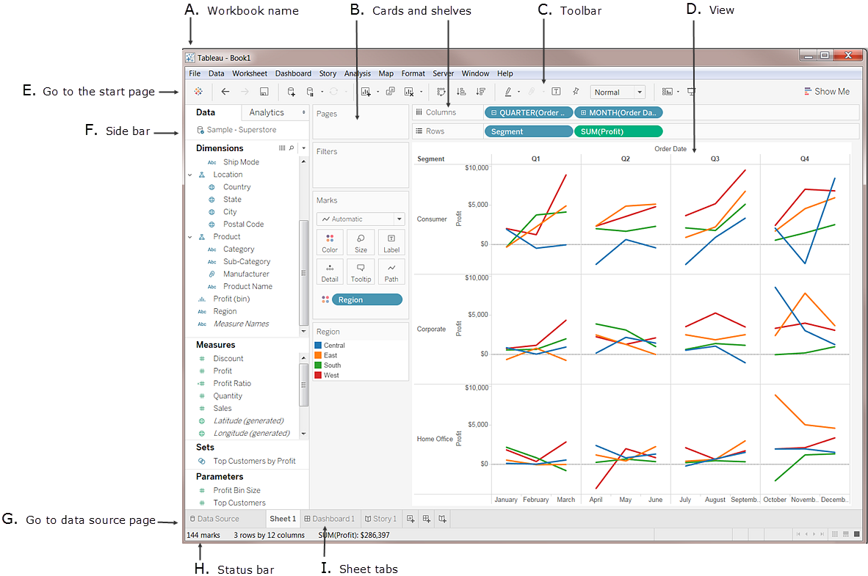
Tableau Workspace
The Tableau workspace consists of menus, a toolbar, the Data pane, cards and shelves, and one or more sheets. Sheets can be worksheets, dashboards, or stories.
Worksheets contain shelves and cards that you can drag and drop data fields on to build views.
A. Workbook name.
B. Cards and shelves - Drag fields to the cards and shelves in the workspace to add data to your view.
C. Toolbar - Use the toolbar to access commands and analysis and navigation tools.
D. View - This is the workspace where you create your data visualizations.
E. Go to the start page. For more information, see Start Page.
F. Side Bar. The side bar provides two panes: the Data pane and the Analytics pane. For more information, see The Side Bar.
G. Go to the data source page. For more information, see Data Source Page.
H. Status bar - Displays information about the current view.
I. Sheet tabs - Tabs represent each sheet in your workbook. This can include worksheets, dashboards and stories. For more information, see Sheets.

Slide 16
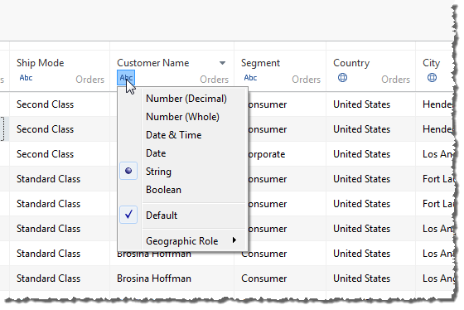
Data Types
All fields in a data source have a data type. The data type reflects the kind of information stored in that field, for example integers (100), dates (1/01/2016) and strings (“Narendra”). The data type of a field is identified in the Data pane by one of the icons shown below.
You can change the data type for a field either on the Data Source page or in the Data pane.
Change the data type for a field in the Data Source page
Sometimes Tableau incorrectly interprets the data type of a field. For example, Tableau might interpret a field that contains dates as an integer data type, rather than a date data type.
You can change the data type for a field that was part of the original data source (as opposed to a calculated field created in Tableau) on the Data Source page.
Click the field type icon for the field (as shown in the table).
Choose a new data type from the drop-down list:

Slide 17
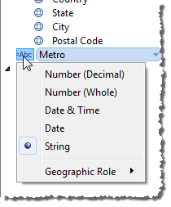
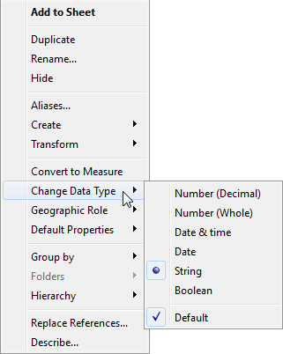
Data Types
Change the data type for a field in the Data pane
To change the data type of a field in the Data pane, click the icon to the left of the field name, and then choose a new data type from the drop-down list.
Change the data type for a field in the view
To change a field's data type in a view, right-click (control-click on a Mac) the field in the Data pane, choose Change Data Type, and then select the appropriate data type from the drop-down list.
Mixed data types in data from files
Most columns in a Microsoft Excel, Microsoft Access, or CSV (comma-separated value) file contain values that are all of the same data type (Booleans, dates, numbers, or text). When you connect to the file, Tableau creates a field in the appropriate area of the Data pane for each column. Dates and text values are dimensions, and numbers are measures.
However, files that you connect to might include columns that have a mixture of data types, such as numbers and text, or numbers and dates. When you connect to the file, the mixed-value column is mapped to a field with a single data type in Tableau. Therefore, a column that contains numbers and dates might be mapped as a number data type (making it a measure) or it might be mapped as a date data type (in which case Tableau treats it as a dimension.)
Tableau determines how to map mixed-value columns to data types by the data types of the first 10,000 rows in an Excel data source, and the first 1,024 rows in a CSV data source. For example, if most of the first 10,000 rows are text values, the entire column is mapped to use the text data type.
When Tableau determines a data type for each field, if the values in a field don't match that data type, Tableau handles the field in one of several different ways, depending on the data type. For example, sometimes Tableau populates those fields with Null values, as shown in the following table:
If using fields that are based on mixed-value columns introduces difficulties when yanalyzing your data, you can do one of the following:
Format empty cells in your underlying data source so that they match the data type of the column.
Create a new column that does not contain the mixed values.
Mapped data type | Treatment of other data types in the field.
Text | Dates and numbers are treated as text. Nulls are not created.
Dates | Text is treated as Null. A number is treated as the day in numeric order from 1/1/1900.
Numbers | Text is treated as Null. A date is treated as the number of days since 1/1/1900.
Boolean | Text, dates, and numbers are treated as Null.

Slide 18
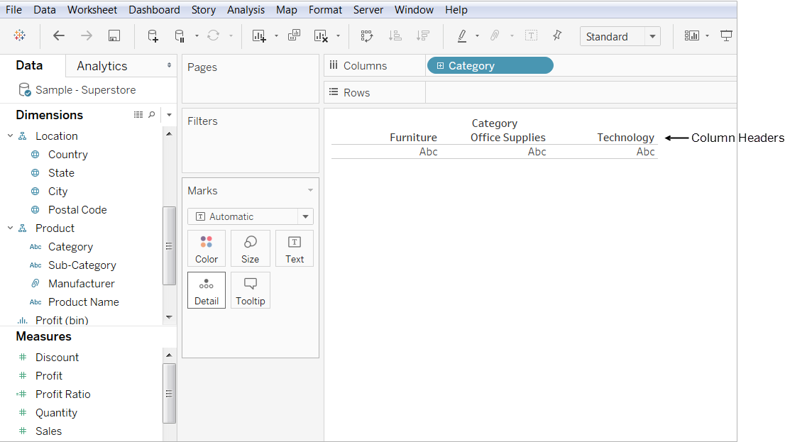
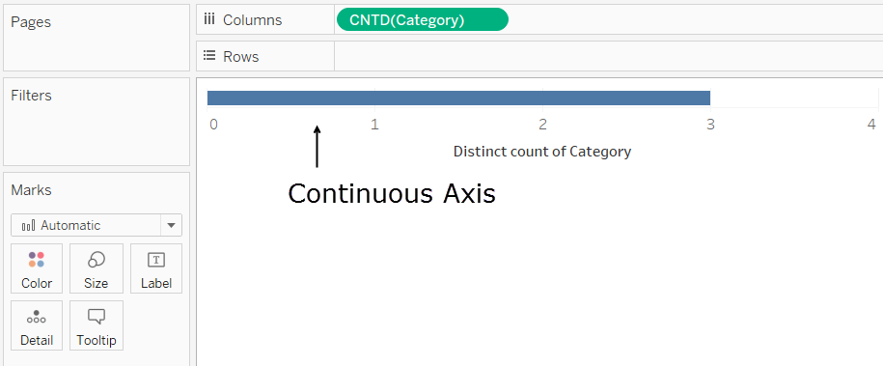
Dimensions and Measures
When you connect to a data source, Tableau assigns each field in the data source as playing one of two possible data roles: dimension or measure. What effect do these assignment have when you start working with data in Tableau.
Dimensions
When you first connect to a data source, Tableau assigns any fields that contain discrete categorical information (for example, fields where the values are strings or Boolean values) to the Dimensions area in the Data pane.
When you click and drag a field from the Dimensions area to Rows or Columns,
Tableau creates column or row headers.
Any field you drag from the Dimension area will initially be discrete when you add it to a view,
with a blue background. For this reason, it might be easy to assume (incorrectly, as it turns out) that a field's background color indicates whether it is a dimension or a measure.
But Date dimensions and numeric dimensions can be either discrete or continuous, and all measures can be discrete or continuous. A field's background color indicates whether it is discrete (blue) or continuous (green).
After you drag a dimension to Rows or Columns, you can change the field to a measure just by clicking the field and choosing Measure.
Now the view will contain a continuous axis instead of column or row headers, and the field's background will become green:

Slide 19
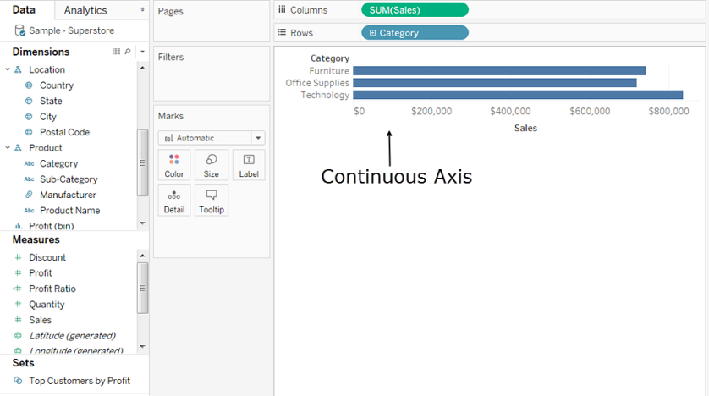
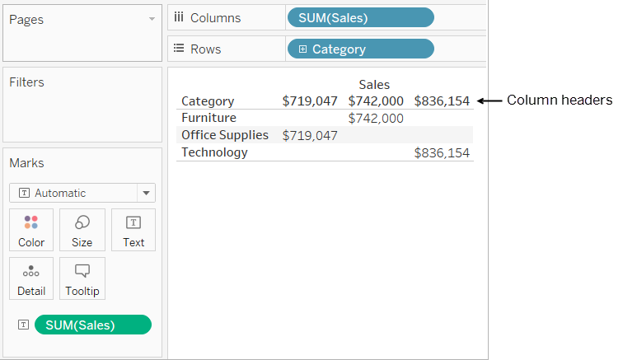
Dimensions and Measures
If you want to make a dimension continuous (without first converting it into a measure), your options are limited. This is only possible with Date dimensions, which can be discrete or continuous but are always dimensions, and with numeric dimensions. You cannot convert dimensions containing strings or Boolean values.
Tableau does not aggregate dimensions. If you want a field's values to be aggregated, that field must be a measure. When you convert a dimension into a measure, Tableau will always prompt you to assign it an aggregation (Count, Average, etc.). Aggregation means collecting multiple values (individual numbers) into a single number by, for example, counting the number of individual values, averaging them, or displaying the smallest individual value for any row in the data source. For a discussion of the different types of aggregation Tableau can perform, see Aggregations.
In Tableau queries, dimensions in the view are expressed in SQL as "Group By" clauses.
Measures
When you first connect to a data source, Tableau assigns any fields that contain quantitative, numerical information (that is, fields where the values are numbers) to the Measures area in the Data pane.
When you drag a field from the Measures area to Rows or Columns, Tableau creates a continuous axis.
Any field that you drag from the Measures area will initially be continuous when you add it to the view, and so its background will be green. But if you then click the field and choose Discrete, the values become column headers.
Tableau continues to aggregate values for the field, because even though the field is now discrete, it is still a measure, and
Tableau will always aggregate measures. You can take the process one step further and convert the measure to a dimension if you like.
Only then will Tableau stop aggregating its values. See Convert a Measure to a Dimension for an example of this process.

Slide 20
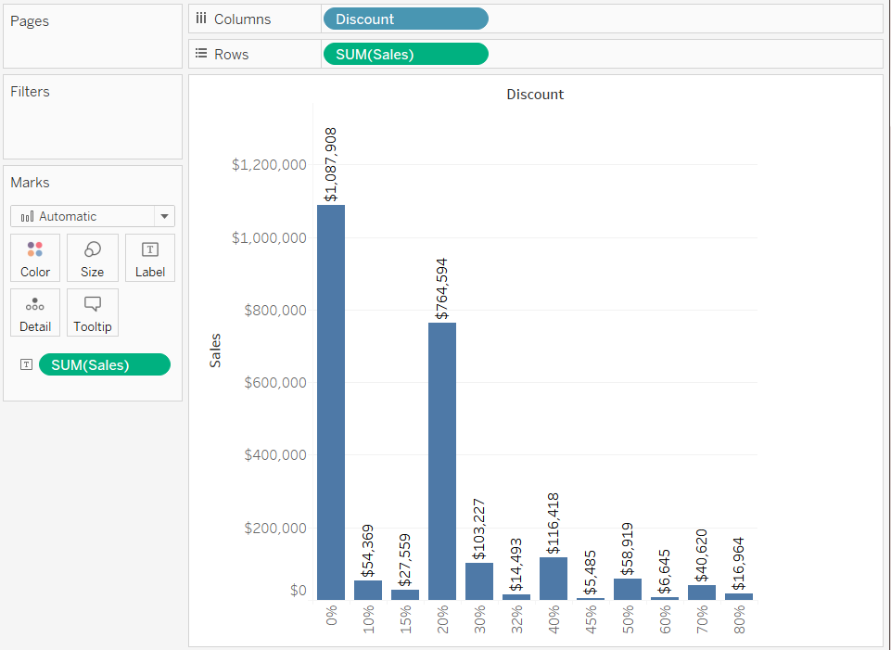
Convert a Measure to Dimension
You can convert a field in a view from a measure to a dimension.
Or, if you want the change to affect all future uses of the field in the workbook, you can convert a field in the Data pane from a measure to a dimension.
Convert a measure in the view into a discrete dimension
You can drag a field from the Measures area in the Data pane but then use it as a dimension in the view. For example, suppose you want to know the aggregated sales totals for each possible discount rate. The view you are aiming for looks like this:
Continuous and Discrete
Continuous and discrete are mathematical terms. Continuous means "forming an unbroken whole,
without interruption"; discrete means "individually separate and distinct."
In Tableau, fields can be either continuous or discrete. When you drag a field from the Measures
area to Columns or Rows, the values are continuous by default and Tableau creates an axis.
When you drag a field from the Dimensions area of the Data pane to Columns or Rows, the values are discrete by
default and Tableau creates column or row headers. Let's consider why this is so
Continuous fields produce axis
If a field has values that are numbers that can be added, averaged, or otherwise aggregated, Tableau assigns that field to the Measures area of the Data pane when you first connect to a data source. Tableau is assuming that the values are continuous.
Tableau displays an axis when you drop a continuous field on Rows or Columns. An axis is a measuring line that shows values between a minimum and a maximum. Rulers and analog thermometers are examples of physical objects that display axis.
Tableau must be able to show a range of actual and potential values, because in addition to the initial values in the data source, it is always possible that new values will emerge as you work with a continuous field in the view.
While there are value labels on a continuous axis (0, 0.5, ... 3.0 in the following image), actual marks don't have to align with these labels as they would with column headers. For example, in the following image, the blue bar actually extends to a value of 6.940 on the horizontal axis, not 7.0 exactly.

Slide 21
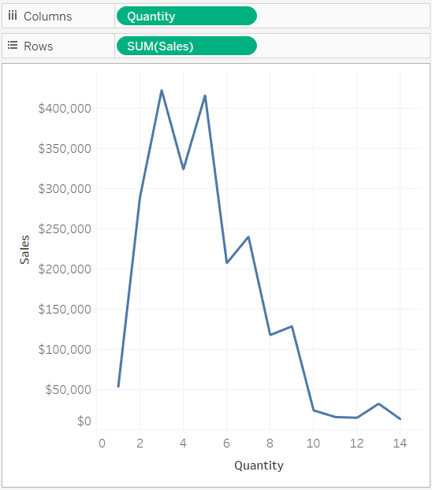
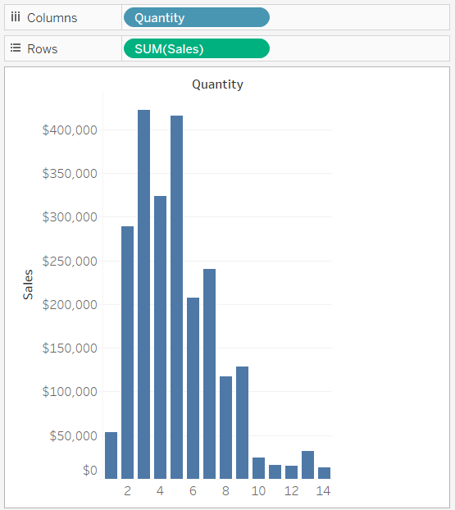
Convert a Measure to Dimension
The number of potential values for continuous fields is impossible to anticipate. For example, if you have a field named Ratings and the initial values are 1, 3, 3.5, 3.6, and 4, that's five distinct values. But if you drop Ratings on Rows, Tableau automatically aggregates that value as SUM (which you would then immediately change to AVG, because it's more logical to average grades than to add them), and that would then create a sixth value (3.02) that didn't exist until you added the field to the view. And if you then applied a filter that eliminated two of the initial values, the average would change as well, so that would be yet another value. And then if you changed the aggregation, ... You get the idea. The number of potential values is, if not infinite, then certainly immense.
The fact that a field contains numbers does not automatically indicate that those values are continuous. Postal codes are the classic example: though they are often composed entirely of numbers, they are actually string values which should never be added or averaged. If Tableau assigns such a field to the Measures area, you should drag it up to the Dimensions area
Discrete fields create headers
If a field contains values that are names, dates, or geographical locations—anything other than numbers—Tableau assigns that field to the Dimensions area of the Data pane when you first connect to a data source. Tableau treats the values as discrete.
Tableau creates headers when you drop a discrete field on Columns or Rows. The individual values for a discrete field become the row or column headings. (Because such values are never aggregated, no new field values are created as you work with your view, so there is no need for an axis).
Recognizing the difference
If a field is continuous, the background color is green. If it is discrete, the background color is blue. Background color does not indicate dimension vs. measure—it indicates continuous vs. discrete.
What tells you whether a field in the view is a measure or a dimension is whether it is aggregated.
On the left below you see a view where Quantity, which was dragged from the Measures area of the Data pane, has been converted from a measure to a dimension but is still continuous, with an axis along the bottom of the view. We know that the field is continuous because of the axis and because the background is green. We know that it is a dimension because it is not aggregated.
On the right, you see a view where that view has been further modified by clicking Quantity on the Columns shelf and choosing Discrete. Now there are headers along the bottom of the view, instead of an axis.
Continuous
Discrete

Slide 22
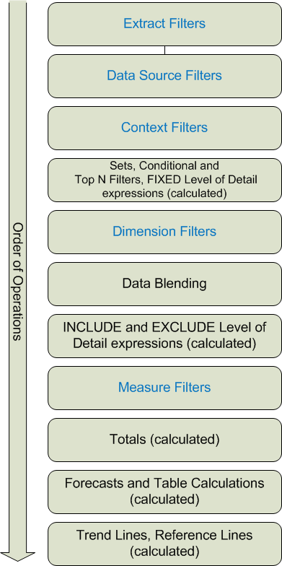
Tableau's Order of Operations
The order of operations in Tableau, sometimes called the query pipeline, is the order in which Tableau performs various actions. (Actions are also known as operations).
Many operations apply filters, which means that as you build a view and add filters, those filters always execute in the order established by the order of operations.
Sometimes, you might expect Tableau to execute filters in one order, but the order of operations dictates that they be executed in a different order, which gives you unexpected results. When this happens, you can sometimes change the order in which operations are executed in the pipeline.
The Tableau order of operations includes all the elements in the following illustration. Filters are shown in blue; other operations, which are mostly calculations, are shown in black.

Slide 23
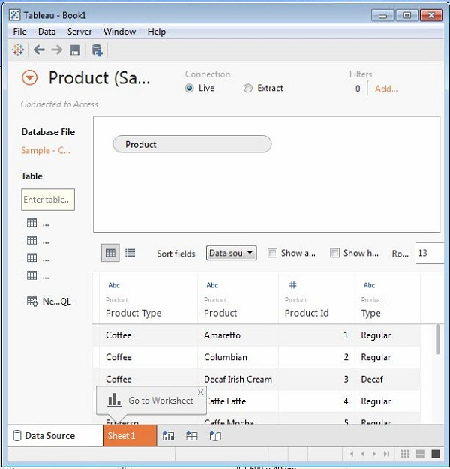
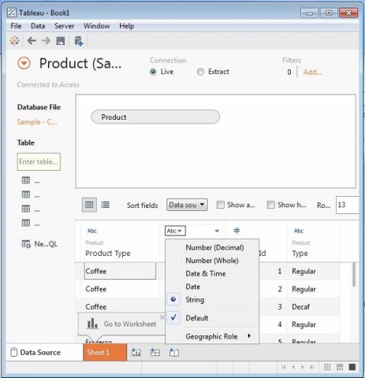
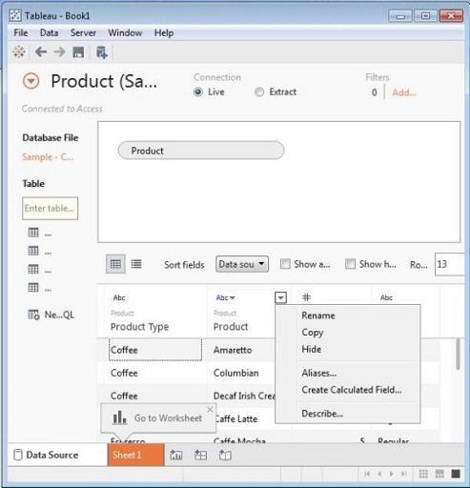
Working with Metadata
After connecting to the data source Tableau captures the metadata details of the source like the columns and their data types. This is used to create the dimensions, measures and calculated fields used the views. We can browse the metadata and change some of its properties for some specific requirements.
Checking the Metadata
After connecting to a data source, Tableau presents all possible tables and columns present in the source, Let's consider the source Sample Coffee shop for checking the metadata. Click the Data menu and choose to connect to a data source. Browse for the MS access file named Sample - Coffee shop. Drag the table named Product to the data canvas. On choosing the file we get the below screen which shows the column names, their Data types. The String data types are shown as Abc and Numeric data types are shown as #.
Changing the data type
We can change the datatype of some of the fields if required. Depending on the nature of source data, sometimes Tableau may fail to recognize the data type from the source. In such scenario we can manually edit the data type. The screen below shows the option.
Renaming and Hiding
The column names can be changed by using the renaming option.
Also we can hide a column so that it does not appear in the data view we create.
These options are available by clicking on the data type icon in the meta data grid
as shown

Slide 24
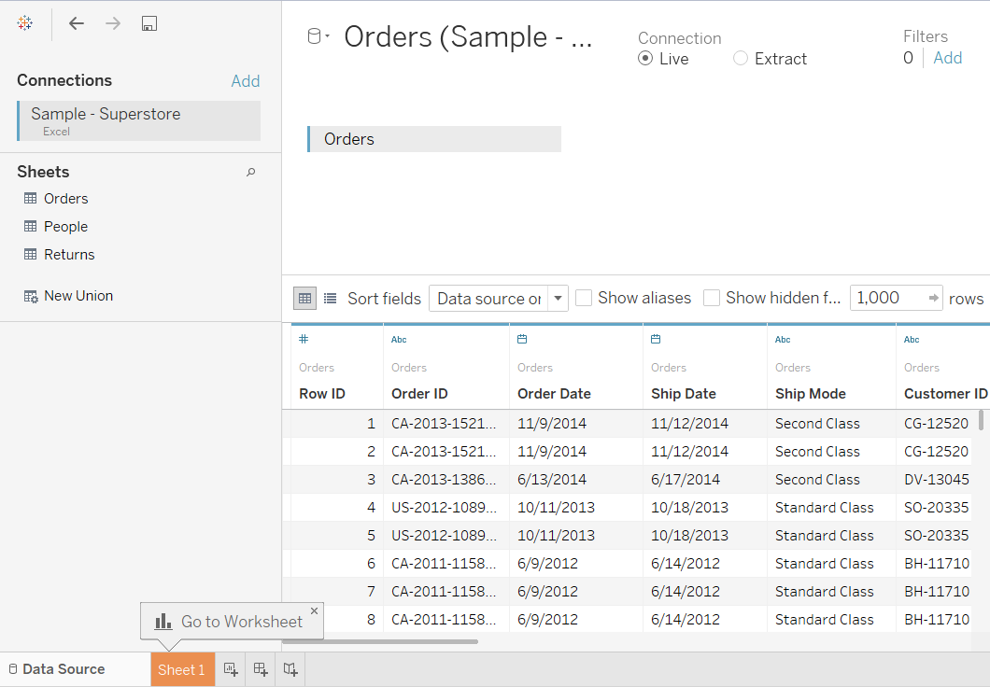
Working with Connections
After connecting to the data source Tableau captures the metadata details of the source like the columns and their data types. This is used to create the dimensions, measures and calculated fields used the views. We can browse the metadata and change some of its properties for some specific requirements.
Checking the Metadata
After connecting to a data source, Tableau presents all possible tables and columns present in the source, Let's consider the source Sample superstore for checking the metadata. Click the Data menu and choose to connect to a data source. Browse for the Sample superstore. Drag the table named Product to the data canvas. On choosing the file we get the below screen which shows the column names, their Data types. The String data types are shown as Abc and Numeric data types are shown as #.
After you have connected to the Excel data, the data source page shows the sheets in your data. You drag one or more sheets to the canvas. You can combine sheets on the canvas to form the data source from which you will build your view.
At the top of the data source page, select how you want to connect to the data.
You can select from the following options:
Live – Creates a direct connection to your data. The speed of your data source will determine performance.
Extract – By default, this option imports the entire data source into Tableau fast data engine as an extract.
The extract is saved with the workbook. If you prefer to import a subset of the data,
click the Edit link. This option requires you specify what data you want to extract using filters.
At the bottom of the data source page, preview the data in your data source in the grid.
You can make the following changes in the grid:
Hide or rename a column by clicking the column header drop-down arrow.
Change the data type by clicking the data type icon in the column header.
Click the sheet tab to go to the new worksheet and begin your analysis

Slide 25
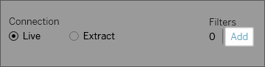
Datasource Filters
Filter Data from Data Sources
You can create filters on a data source, thereby reducing the amount of data in the data source.
If you create an extract from a data source that already has data source filters in place, those filters are automatically recommended as extract filters, and will appear in the Extract dialog. Those recommended filters are not required to be part of the Extract filter list, and can safely be removed without affecting the existing set of data source filters.
Data source filters can be useful for restricting the data users can see when you publish a workbook or data source. When you publish a data source to Tableau Server, the data source and any associated files or extracts are transported in entirety to the Server. As you publish a data source you can define access permissions for downloading or modifying the data source, and you can also choose the users and groups who can remotely issue queries through Tableau Server against that data source. When users have query permission and no download permission, you can share a rich data model having calculated fields, aliases, groups, sets and more—but only for querying.
Furthermore, users who query published data source will never be able to see or modify any data source filters present on the originally published data source, but all of the users' queries will be subject to those data source filters. This is a great way to offer a restricted subset of your data, for example by filtering dimensions for specific users and groups, or by defining data source filters based on a fixed or relative date range. This is often useful for data security, and it also allows you to manage performance of the remote database which Tableau Server will ultimately query on a user's behalf. For systems that rely heavily on partitions or indexing, data source filters may yield tremendous control over the performance of queries issued by Tableau.
Create a data source filter
The primary way to create a data source filter is from the data source page.
To create a data source filter
On the data source page, click Add in the Filters section in the upper-right corner of the page
To create a data source filter on a worksheet, right-click (control-click on a Mac) the data source and choose Edit Data Source Filters.
Whether you start from the Data Source page or from a worksheet, you see an Edit Data Source Filter dialog box, listing any existing data source filters.
Click Add to open an Add Filter dialog box listing all fields in the data source.
Click to select a field to filter; then specify how the field should be filtered, just as you would for a field on the Filters shelf.
To add an additional data source filter, repeat this procedure.

Slide 26
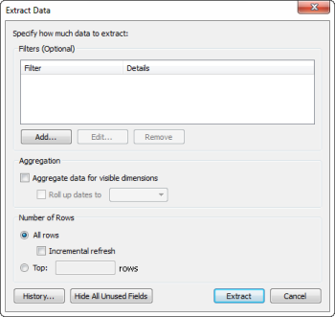
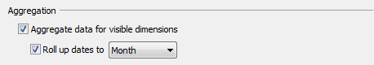
Extract Filters
Extracts are saved subsets of a data source that you can use to improve performance or to take advantage of Tableau functionality that is not available in the underlying data. When you extract your data to create an extract, you can reduce the total amount of data by defining filters and limits. After you create an extract you can refresh it with data from the original data. When refreshing the data, you have the option to either fully refresh the data, which replaces all of the extract contents, or you can incrementally refresh the extract, which only adds rows that are new since the previous refresh.
Extracts can:
Improve performance. For file based data sources such as Excel or Access, a full extract takes advantage of the Tableau data engine. For large data sources, a filtered extract can limit the load on the server when you only need a subset of data.
Take advantage of Tableau functionality that is not available in the original data source, such as the ability to compute Count Distinct.
Provide offline access to your data. If your data source is not available (for example, because you are traveling), you can extract the data to a local data source.
To create an extract
On the Data Source page, select a data source on the Data menu and then select Extract Data to open the Extract Data dialog box.
Optionally define filters to limit the data that will be extracted. Any fields that are hidden
in the Data pane will be automatically excluded from the extract.
Click the Hide All Unused Fields button to quickly remove them from the extract.
To add filters, click the Add button under the Filters list.
Specify whether to Aggregate data for visible dimensions.
When you select this option the measures are aggregated using their default aggregation.
Aggregating the data can minimize the size of the extract file and increase performance.
When you choose to aggregate the data you can also choose to Roll up dates to a specified date level such as Year, Month, etc.

Slide 27
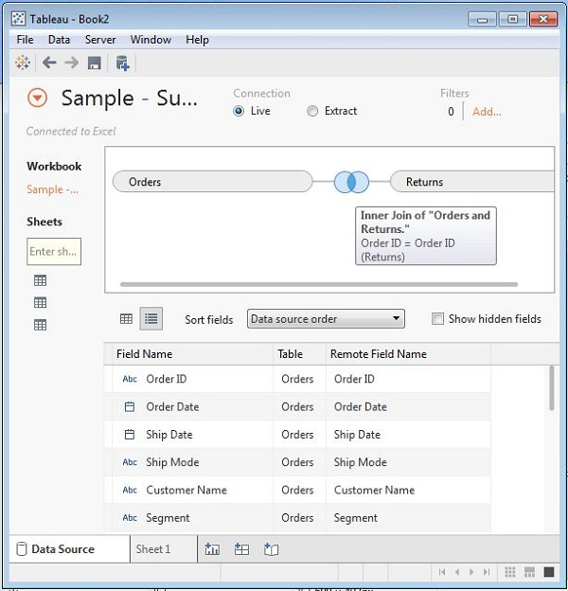
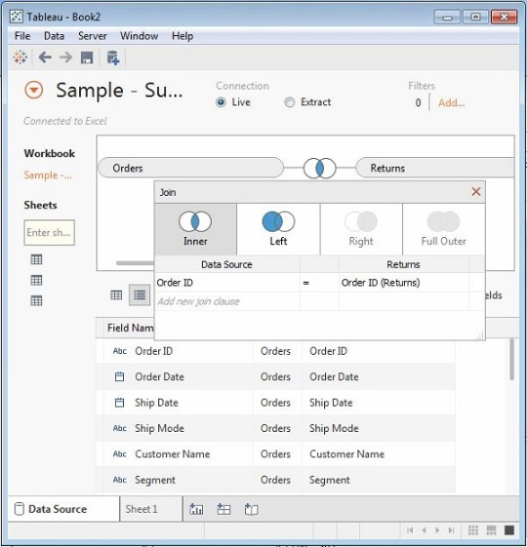
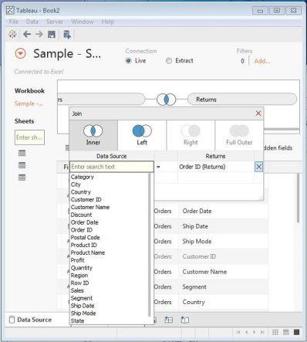
Joins
Data joining is a very common requirement in any data analysis. We may need to join data from multiple sources or join data from different tables in a single source. Tableau provides the feature to join the table by using the data pane available under Edit Data Source in the Data menu.
Creating a Join
Let's consider the data source Sample superstore to create a join between Orders and Returns table. For this we go to the Data menu and choose the option Edit Data Source. Next we drag the two tables, orders and Returns to the data pane. Depending on the field name and datatype, Tableau will automatically create a join which can be changed later.
The below diagram shows the creation of inner join between orders and Returns using the field Order ID.
Editing Join Type
The type of join which Table creates automatically can be changed manually.
For this we click on the middle of the two circles showing the join.
A popup window appears below which shows the four types of joins available.
Also Tableau automatically greys out some types of joins which it finds irrelevant
on the basis of data present in the data source.
In the below diagram we see the inner and left outer join as the available joins.
Editing Join Fields
We can also change the fields forming the join condition by clicking on the
Data Source option available in the join popup window.
While selecting the field we can also search for the field we are looking for using a search text box.

Slide 28
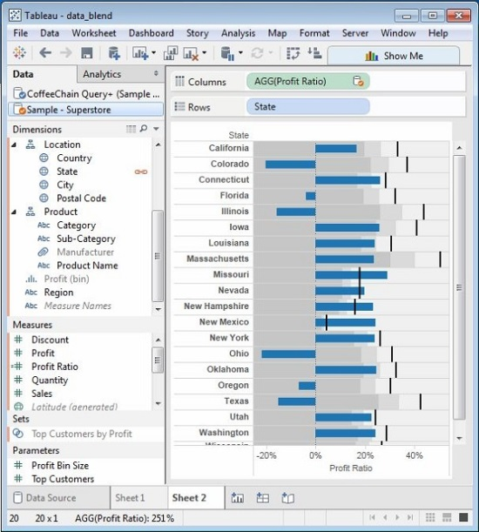
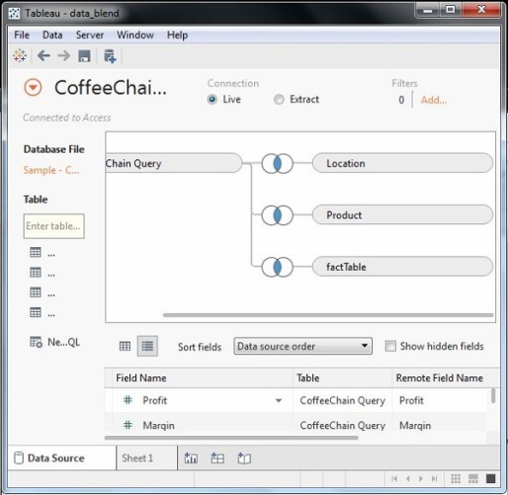
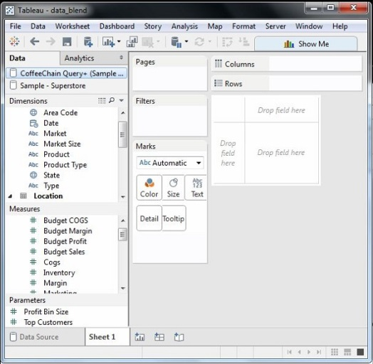
Data Blending
Data Blending is a very powerful feature in Tableau. It is used when there is related data in multiple data sources which you want to analyze together in a single view. As an example, the Sales data is present in a relational database and Sales Target data in an Excel spreadsheet. Then to compare actual sales to target sales, we can blend the data based on common dimensions to get access to the Sales Target measure. The two sources involved in data blending are referred as Primary and secondary data sources. A left join is created between the primary data source and the secondary data source with all the data rows from primary and matching data rows from secondary data source.
Preparing Data for Blending
Tableau has two inbuilt data sources named Sample-superstore and Sample coffee chain.mdb which we will use to illustrate data blending. Let’s first load the sample coffee chain to tableau and look at its metadata. Go to the menu Data -> New Data Source and browse for the sample coffee chain file which is a MS access database file. The below diagram shows the different tables and joins available in the file.
Adding Secondary Data Source
Next we add the secondary data source named Sample-superstore by again following the steps Data -> New Data Source and choosing this data source. Both the data sources now appear on the Data window as shown below.
Blending the Data
Now we can integrate the data from both the above sources based on a common dimension. Note that a small chain image appears next to the dimension named State. This indicates the common dimension between the two data sources. We drag the State field from the primary data source to the rows shelf and the field Profit Ratio from the secondary data source to the Columns shelf. We select the bullet chart option from Show me to get the bullet chart below. It shown how the profit ratio varies for each state in both the superstore and coffee chain shops.

Slide 29
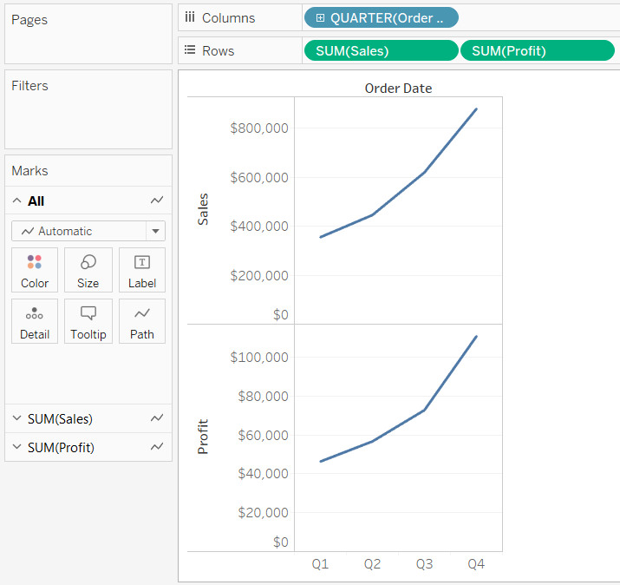
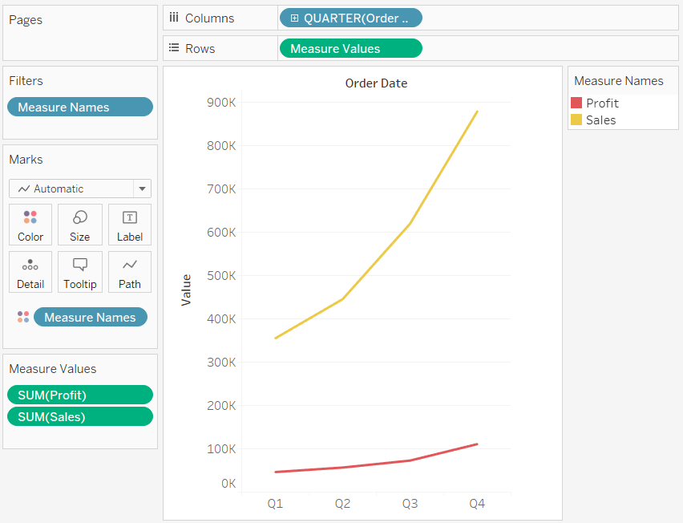
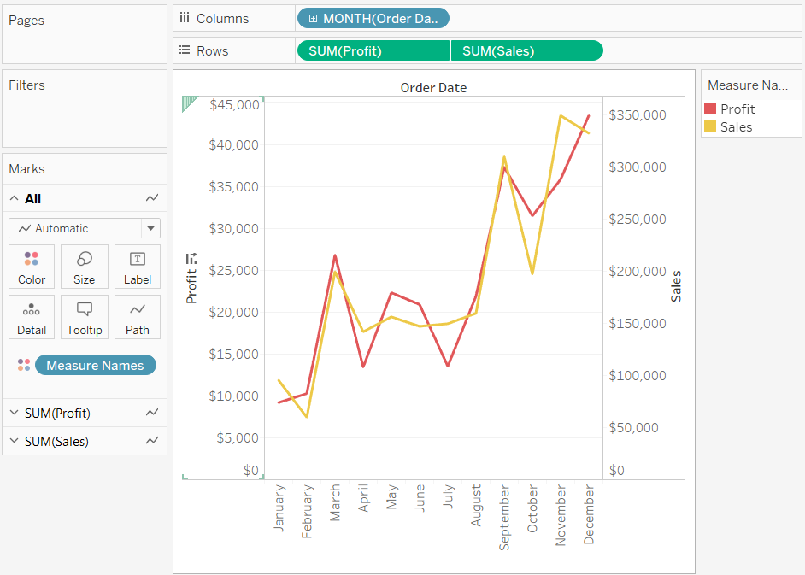
Individual axis
Add individual axis for each measure by dragging measures to the Rows and Columns shelves. Each measure on the Rows shelf adds an additional axis to the rows of the table. Each measure on the Columns shelf adds an additional axis to the columns of the table. For example, the view below shows quarterly sales and profit. The Sales and Profit axis are individual rows in the table and have independent scales.
Blended Axis:
Measures can share a single axis so that all the marks are shown in a single pane. Instead of adding rows and columns to the view, when you blend measures there is a single row or column and all of the values for each measure is shown along one continuous axis. For example, the view below shows quarterly sales and profit on a shared axis.
Dual Axis
You can compare multiple measures using dual axes, which are two independent axes that are layered on top of each other.
Dual axes are useful when you have two measures that have different scales. To add a measure as a dual axis, drag the field to the right side of the view and drop it when you see a black dashed line appear. You can also right-click (control-click on Mac) the measure on the Columns or Rows shelf and select Dual Axis.

Slide 30
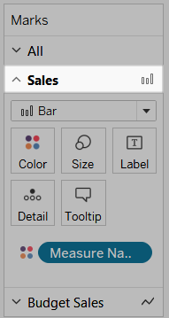
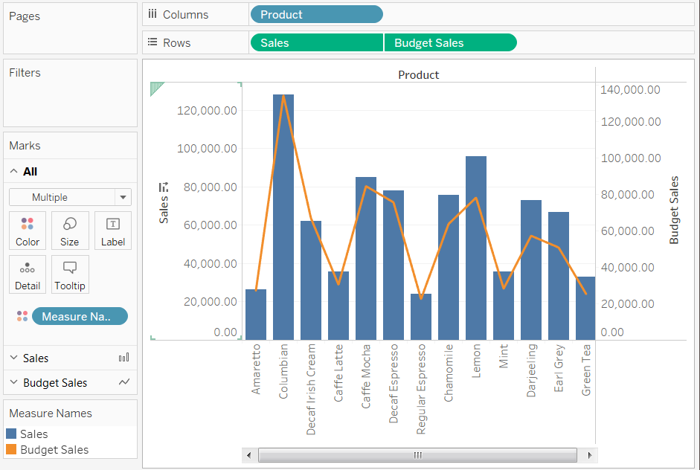
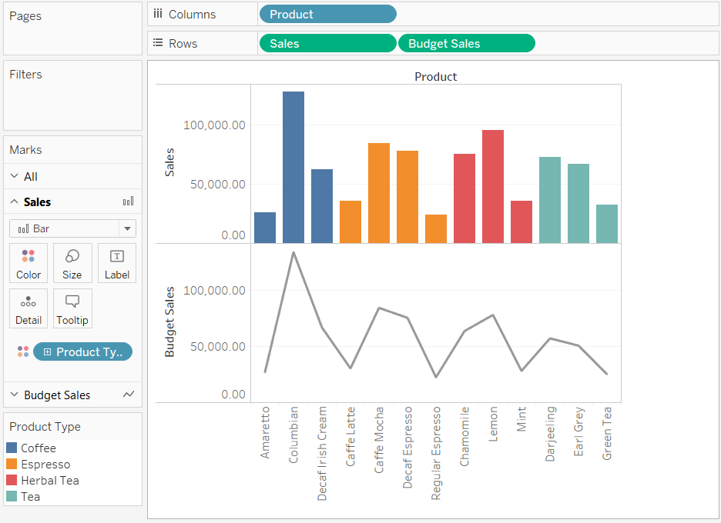
Combinational Charts
When working with multiple measures in a view, you can customize the mark type for each distinct measure. For example, you can create a view with a line showing a target amount across several months and a bar chart showing the actual attainment for the months. These measures can be displayed as individual axes, blended axes, or dual axes.
Because each measure can have customized marks, you can customize the level of detail, size, shape, and color encoding for each measure too.
Customize the marks for a measure:
Select the Marks card for the measure that you want to customize.
There is a Marks card for each measure on the Rows and Columns shelves.
Mark Card
Select a new mark type for the measure. Any changes to the mark type,
shape, size, color, detail and other mark properties will be applied to
the selected measure. For example, in the view below the
Sales Marks card is active. The Mark Type has been changed to Bar and
when Product Type is placed on Color on the Sales Marks card, the encoding
and level of detail is only applied to the Sales marks.
The Budget Sales mark is not broken down by Product Type.
Tip: Select the All Marks card to modify properties for all measures at once.

Slide 31
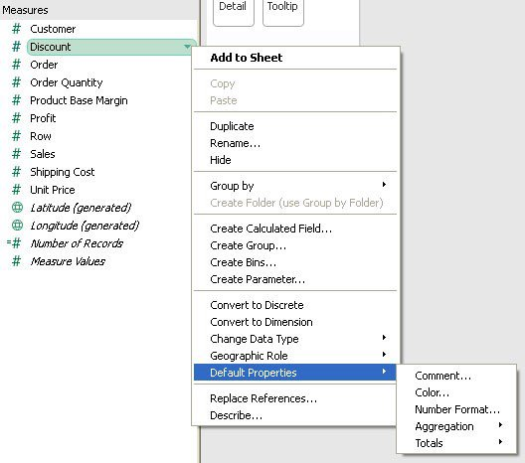
Default properties
Tableau does a pretty good job of figuring out which fields go where and how they can be used in your data visualizations. Sometimes, you can add additional information that will make Tableau even more effective. Measures are numerical fields that can be used in aggregation, but not all measures were meant to be simply summed.
For instance, assume that your data source had a field labeled, “Profit Margin.” Clearly, this is a measure and not a dimension, but would it make any sense to sum your Profit Margin like you might your Total Sales Revenue?
Nope. That’s why editing the Default Properties is so important, because it gives Tableau a clue as to how to use your data better and, wait for it, save you tons of time in the long run.
You can access the Default Properties menu by simply right-clicking on the measure you wish to adjust or by pressing the down arrow icon when the measure is highlighted.
We can change default properties like totals , aggregation, color, number format and comment.

Slide 32
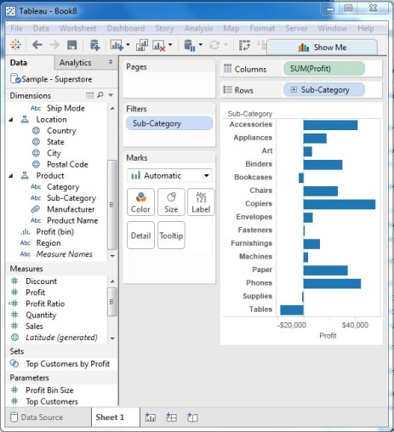
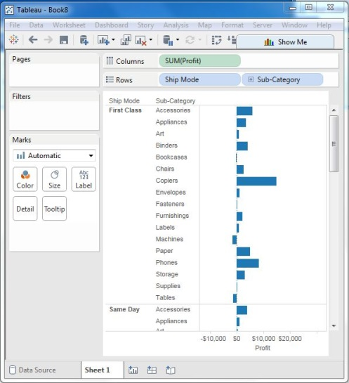
Basic Filters
Apart from Datasource and extract filters we also have other filters.
Filtering is the process of removing certain values or range of values from a result set. Tableau filtering feature allows both simple scenarios using field values as well as advanced calculation or context based filters. In this tutorial we will consider the basic filters available in Tableau.
There are three types of basic filters available in Tableau. They are as follows:
Filter Dimensions are the filters applied on the dimension fields.
Filter Measures are the filters applied on the measure fields.
Filter Dates are the filters applied on the date fields.
Filter Dimensions
These filters are applied on the dimension fields. Typical examples include filtering based on categories of text or numeric values with logical expressions with greater than or less than conditions
Example
We use the Sample - Superstore data source to apply dimension filters on the sub-category of products. We create a view for showing profit for each sub-category of products according to their shipping mode. For it, we drag the dimension field “Sub-Category” to the Rows shelf and the measure field “profit” to the Columns shelf.
Next drag the Sub-Category dimension to the Filters shelf to open the Filter dialog box. Click the None button at the bottom of the list to deselect all segments. Then select the Exclude option in the lower right corner of the dialog box. Finally, select Labels and Storage and then click OK. The below picture shows the result with the above two categories excluded.

Slide 33
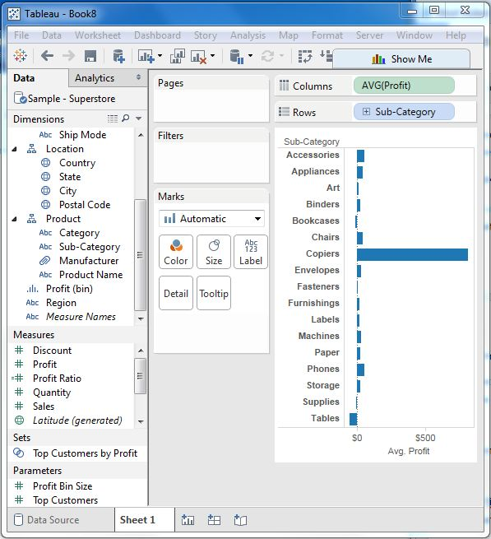
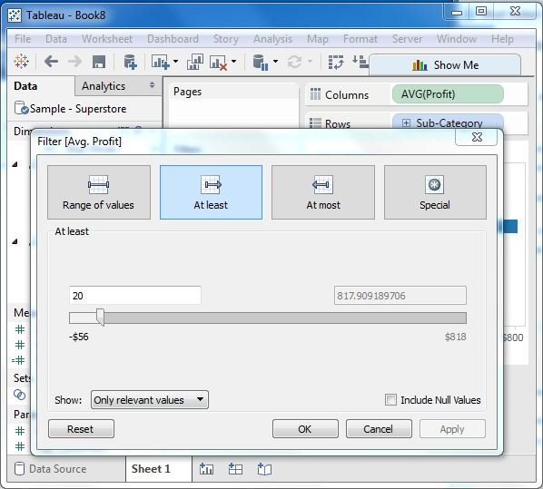
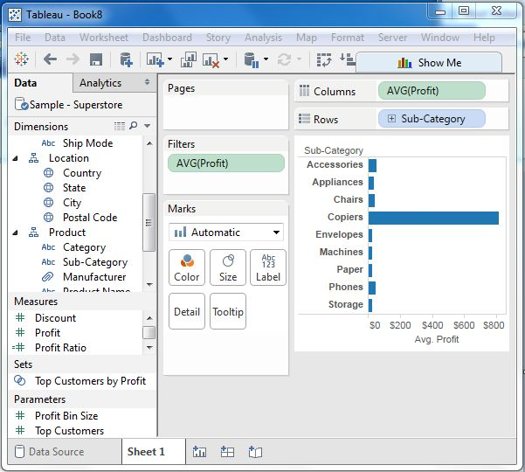
Basic Filters
Filter Measures
These filters are applied on the measure fields. Filtering is based on the calculations applied to the measure fields. So, while in dimension filters we use only values to filter, in measures filter we use calculations based on fields.
Example
We use the Sample - Superstore data source to apply dimension filters on the average value of the profits. First we caret a view with ship mode and subcategory as dimensions and Average of profit as shown below.
Next we drag the AVG (profit) value to the filter pane. Choose Average as the filter mode.
Next choose "At least" and give a value to filter the rows which meet these criteria.
On finishing the above steps we get the final view below showing only
the subcategories whose average profit is greater than 20.

Slide 34
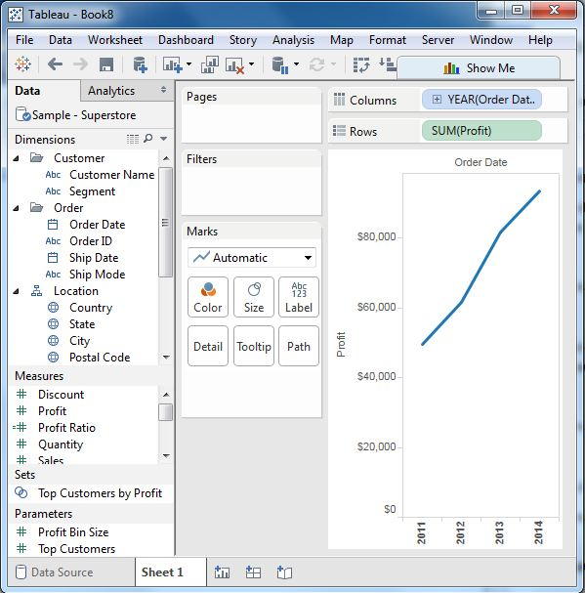
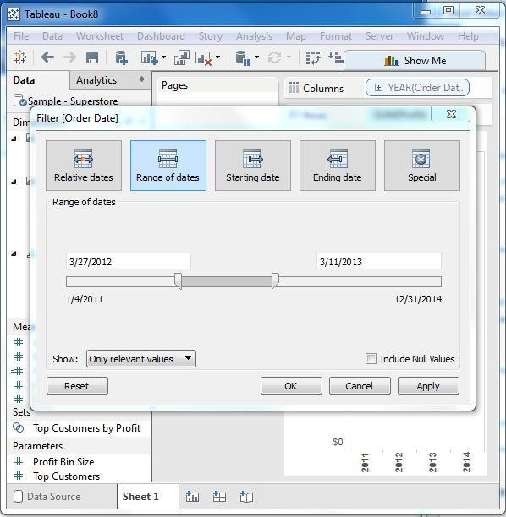
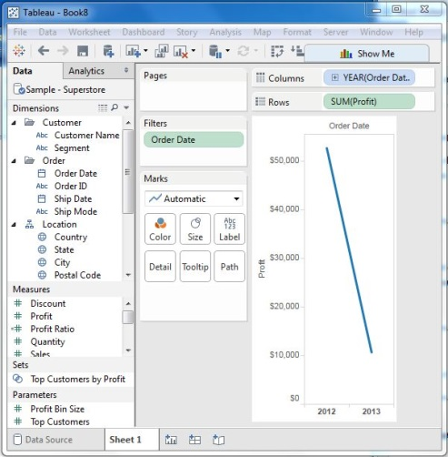
Basic Filters
Filter Dates
Tableau treats the date field in three different ways while applying the date field. It can apply filter by taking a relative date as compared to today, an absolute date or range of dates. Each of this option is presented when a date field is dragged out of the filter pane.
Example
We choose the sample - Superstore data source and create a view with order date in the column shelf and profit in the rows shelf as shown below.
Next drag the "order date" field to the filter shelf and choose Range of dates in the filter dialog box.
Choose the dates as shown below.
On clicking ok the below final view appears
showing the result for the chosen range of dates.

Slide 35
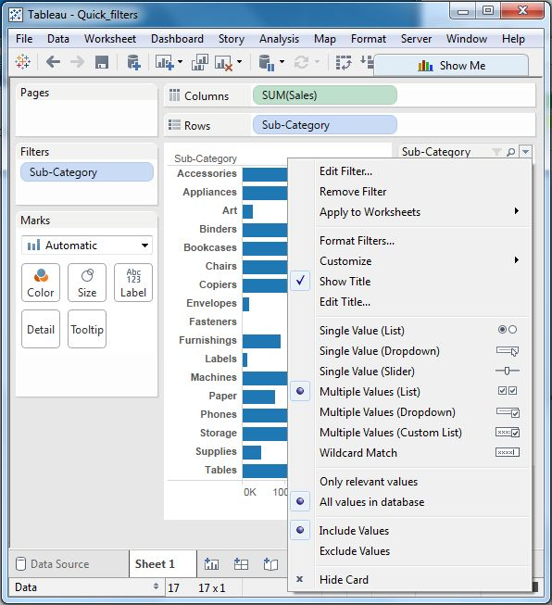
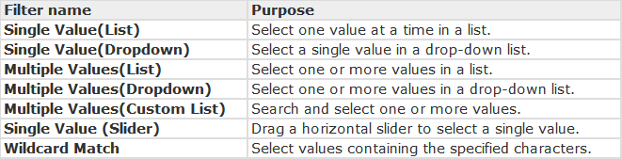
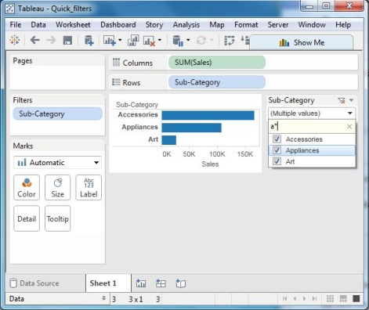
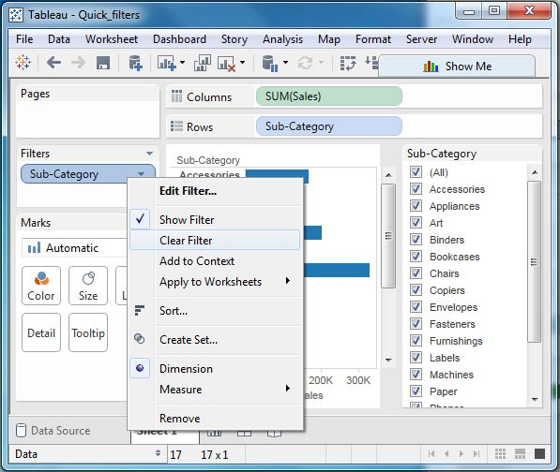
Quick Filters
Many filter types in Tableau are quickly available using right-click option on the dimension or measure. These filters known as Quick filters have enough functionality solve most of the common filtering needs.
The following screen shows how the quick filters are accessed.
A list of various quick filters and their use is given below.
Example
We take the Sample-Superstore data source to apply some quick filters. In the below example, we choose sub-category as the row and sales as the column which by default produces a horizontal bar chart. Next we drag sub-category field to filters pane. All the subcategories appear next to the chart. We apply wildcard filtering using the expression a* which selects all subcategory name starting with “a”.The below screen shows the result of applying this filter where only the sub-categories starting with “A” are displayed.
Clearing the Filter
Once we complete our analysis by applying the filter, we can remove it by using the clear filter option. For this, we go to the filter Pane, right click on the filed name and choose Clear Filter as shown below.

Slide 36
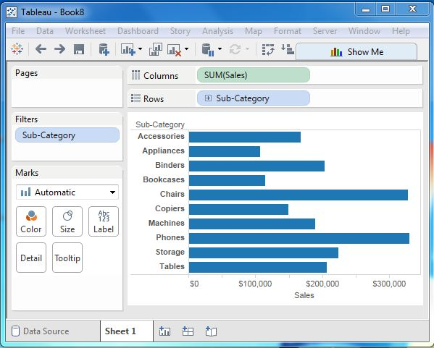
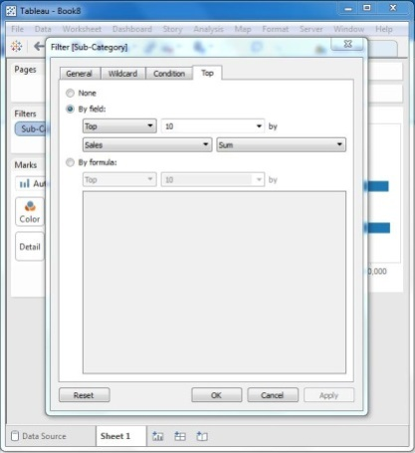
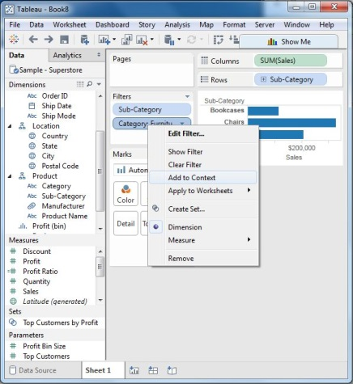

Context Filters
The normal filters in Tableau are independent of each other. It means each of the filter reads all the rows from the source data and creates its own result. But there may be scenarios where we want the second filter to process only the records returned by the first filter. So in this case the second filter is known as dependent filters because they process only the data that passes through the context filter. Context Filters serve two main purposes.
Improve performance – If you set a lot of filters or have a large data source, the queries can be slow. You can set one or more context filters to improve performance.
Create a dependent numerical or top N filter – You can set a context filter to include only the data of interest, and then set a numerical or a top N filter.
Creating Context Filter
Using the Sample-superstore, let's find the top 10 sub-Category of products for the category called furniture .To achieve this objective we follow the below steps.
Step-1
Drag the dimension sub-Category to the Rows shelf and the measure Sales to the Columns Shelf. Choose horizontal bar chart as chart type. Drag the dimension Sub-Category again to the filters shelf. We get the below chart.
Step-2
Right click on the field Sub-Category in the filter shelf and go the fourth tab named Top. Choose the option by field. From the next drop down choose the option Top 10 by Sales Sum as shown below.
Step-3
Drag the dimension Category to the filter shelf. Right click it to edit and under the general tab choose Furniture from the list. As you can see the result shows three subcategory of products.
Step-4
Right click the Category-Furniture filter and select the option Add to Context. This produces the final result which shows the subcategory of products from the category Furniture which are among top 10 subcategories across all the products.
1
2
3
4

Slide 37



Conditional Filters
One of the important filtering options in Tableau is to apply some conditions to already existing filters. These conditions can be very simple like finding only those sales which are higher than certain amount or it can be a complex one based on certain formula. The conditions can also be applied to create a range filter.
Creating Condition Filter
Using the Sample-superstore, let's find that sub-category of products across all segments whose sales exceed one million. To achieve this objective we follow the below steps.
Step-1
Drag the dimension segment and the measure Sales to the Column shelf. Next drag the dimension Sub-Category to the rows shelf. Choose horizontal bar chart option. Then we get the following chart.
Step-2
Drag the dimension Sub-Category to the Filters Shelf. Right click it to edit and go to the tab Condition. Here we choose the radio option by field. From the drop downs select Sales, Sum and greater than equal to symbol specifying the value 100000.
On finishing the above two steps we get a chart which shows only those subcategory of products which have the required amount of sale. Also this is shown for all the available segments where the condition is met.
1
2

Slide 38
Apply Filters to Multiple Worksheets
When you add a filter to a worksheet, by default it applies to the current worksheet. Sometimes, however, you might want to apply the filter to other worksheets in the workbook.
You can select specific worksheets to apply the filter to or apply it globally to all worksheets that use the same data source or related data sources. For example, you might have a filter that only includes a specific region or product of interest. Rather than adding this filter every time you create a new worksheet, you can simply create the filter once and then apply it to multiple worksheets.
Apply filters to all worksheets that use a related primary data source
This option applies the filter to all worksheets that use related data sources as their primary data source. For more information, see Filter Data Across Multiple Data Sources.
To apply a filter to all worksheets using a related primary data source:
On the Filters shelf, right-click the field and select Apply to Worksheets > All Using Related Data Sources.
Filters that use this option are global across the workbook.
Filters that apply to all related data sources are marked with an icon. The filter is automatically created on any existing worksheets, and on any new worksheets you create that use a related data source.
Any changes you make to the filter affects all of those worksheets.
Apply filters to all worksheets that use the current primary data source
This option applies the filter to all worksheets that use the current worksheet's primary data source as their primary data source.
To apply a filter to all worksheets using the current primary data source:
On the Filters shelf, right-click the field and select Apply to Worksheets > All Using This Data Source.
Filters that use this option are global across the workbook.
Filters that apply to all worksheets are marked with a data source icon . The filter is automatically created on any new worksheets you create after you drag a field to the view.
Any changes you make to the filter affects all of those worksheets.
Note: If blending multiple data sources in a view, the All Using This Data Source option applies to the filter if it is the primary data source.
Apply filters to select worksheets
This option opens a dialog box where you can select from a list of worksheets that use the same data source or related data sources.
To apply a filter to select worksheets:
On the Filters shelf, right-click the field and select Apply to Worksheets > Selected Worksheets.
In the Apply Filter to Worksheets dialog box, select the worksheets that you want to apply the filter. If any of the sheets already contain a filter on the same field, the dialog box will provide details about the filter.
If you select the sheet, the current filter will override any existing filter selections.

Slide 39

Apply Filters to Multiple Worksheets
Filters that apply to a selection of worksheets are marked with the worksheet icon . Any changes you make to the filter affect all of the selected worksheets.
Apply filters to the current worksheet only
This option only applies to the current worksheet. This option is selected by default when you create new filters. Filters that are local to the current worksheet are shown without any additional icons.
To apply a filter to the current worksheet only:
On the Filters shelf, right-click the field and select Apply to Worksheets > Only This Worksheet.
If you apply a filter to all worksheets or selected worksheets and then change the setting to apply the filter to just the current worksheet, the filters are not removed from all other worksheets. Rather, the filters are disconnected and they are all made local to their respective worksheets. You can go to each worksheet and remove the filter or modify selections.
Filter all worksheets on a dashboard
This option applies the filter to all worksheets in the dashboard that use the same data source or related data sources as their primary data source.
To filter all worksheets on a dashboard:
In a dashboard, click the drop-down menu on a filter card and select Apply to Worksheets > Selected worksheets.
In the Apply Filter to Worksheets dialog box, click All on dashboard, and then click OK.

Slide 40

Filter Data Across Multiple Data Sources
While working with multiple data sources in a workbook, you might want to compare the data between them using a field they have in common. To do so, you can apply a filter across multiple primary data sources.
For example, the following dashboard shows the order quantity, average sales, and average profit for customers. It has three views. Each of the views uses a different data source as its primary data source, and those data sources all have a field in common: Customer Name. There is also a filter card in the view for Customer Name.
Step 1: Define relationships between your data sources
Before you can create relationships between data sources, you must ensure that there is a common
field between the data sources you're mapping.
The fields do not need to be named the same in each data source, but they should have some data in common.
After you've identified the common fields, you must create relationships between them, or map the fields to one another.
If the fields happen to have the same name, Tableau might recognize them as related automatically.
You can modify an existing relationship that was created automatically by Tableau,
or create a new relationship between two fields in different data sources, by following the procedure below.
To define a relationship between your two data sources:
Select Data > Edit Relationships.
In the Edit Relationships dialog box, do the following:
Select a data source for Primary data source, and select a data source for Secondary data source.
Select Custom.
To define a relationship between fields that have different names, click Add.
To edit an existing relationship, select the fields on the right, and then click Edit.
In the Add/Edit Field Mapping dialog box, do the following, and then click OK:
Under Primary data source field, select a field.
Under Secondary data source field, select a field with similar data to the field you selected for the primary data source.
For more information about editing relationships, see Step 4: (Optional) Define or edit relationships .
Note: After you define your relationships, you do not need to enable blends (that is, you do not have to click the link icon in the Data pane) to filter across your data sources.
For more information about the difference between primary and secondary data sources, see Primary and secondary data sources.

Slide 41



Filter Data Across Multiple Data Sources
Step 2: Add a filter to the view
After you have defined relationships between your data sources, go to one of your worksheets and drag a dimension to the Filters shelf. Then select to include or exclude data from the view. For more information about filtering your data, see Filter Data from Your Views.
Optional Step: Display a filter card in the view. Right-click the field on the Filters shelf and select Show filter. A filter card for that field appears in the view.
For more information about filter cards (previously known as quick filters), see Display interactive filters in the view.
Step 3: Apply the filter to your worksheets
After you set up your filter, you can apply that filter to all the worksheets in your workbook that use related data sources, or you can apply it to selected worksheets.
To apply the filter to all worksheets that use related data sources, right-click the field on the Filters shelf and select Apply to worksheets > All using related data sources.
The Customer Name field is added to the Filters shelf on every worksheet that uses a related data source. An icon is added next to the field on the Filters shelf, indicating that the filter is being applied to multiple data sources.
If you hover over the field on the Filters shelf in any worksheet, you can find details about the type of filter, the source field for the filter, and the other sheets the filter applies to.
To apply the filter to selected worksheets, right-click the field on the Filters shelf and select Apply to worksheets > Selected worksheets.
The Customer Name field is added to the Filters shelf on the worksheets you selected. An icon is added next to the field on the Filters shelf to indicate that the filter is being applied to select worksheets.

Slide 42


Build a Map View
Use map views to display and analyze geographic data. To create map views, add geographic fields to the view, and then add measures or continuous dimensions to the Marks card.
The first exercise in this topic shows you how to create a map view and customize your map appearance. The second exercise in this topic shows you how to create a map view with pie marks.
Build a map view
This exercise demonstrates how to create a custom map view that shows the amount of sales by U.S. city.
Connect to the Sample – Superstore data source.
In the Data pane, double-click the City dimension. Tableau adds Country, State, and City to Detail on the Marks card and creates a map view.
Because Tableau assigns the Country, State, City, and Postcode dimensions a geographic role, a map view is created when you double-click one of these dimensions:
Tableau looks for geographic fields in any data source. For more information on how Tableau interprets geographic data in data sources, see Prepare Your Geographic Fields .
From Measures, drag Sales to Color on the Marks card. The marks in the view color according to the amount of sales in each city.
From Measures, drag Sales to Size on the Marks card. The marks in the view resize according to sales in each city.
To adjust the size of the marks in the view, click Size on the Marks card, and then drag the slider to the right.
The marks in the view are now larger and easier to inspect, though they overlap. Overlapping marks make it difficult to see a difference in the size of some marks.
To make the map view easier to analyze, you can add a border to the marks in the view.
To add a border to the marks in the view, on the Marks card, click Color, and then click the Border drop-down list to select a color.
The marks in the view update to display the selected border:

Slide 43


Build a Map View
After you plot your data on a map view, you can configure the background map style, map layers, and data layers using the Map Layers pane.
To open the Map Layers pane, select Map > Map Layers. In the Map Layers pane, click the Style drop-down list, and then select Dark.
The background map changes from light to dark.
You can now add or subtract map layers to provide context to your data, or to simplify the view.
In the Map Layers pane, clear the Country/Region Names and State/Province Names map layers to simplify the map view.
The country/region and state/province names are removed from the view.
Your view is now complete. Your map view shows total sales for each city in your data source across the United States. The size and the color of each mark corresponds to the total sales for that city.

Slide 44



Bar chart
A bar chart represents data in rectangular bars with length of the bar proportional to the value of the variable. Tableau automatically produces a bar chart when you drag a dimension to the row shelf and measure to the column shelf. We can also use the bar chart option present in the Show Me button. If the data is not appropriate for bar chart then this option will be automatically greyed out.
In Tableau various types of Bar charts can be created by using a dimension and a measure. They are given below.
Simple Bar Chart
From the Sample-Superstore, we choose the dimension, we take profit to the columns shelf and sub category to the rows shelf. It automatically produces a horizontal bar chart as shown below. In case it does not, you can choose the chart type from the show me tool to get the below result.
Bar Chart with Colour Range
We can apply colours to the bars based on their ranges. The longer bars get darker shades and the smaller bars get the lighter shades. To do this, we drag the profit field to the color pallette under the Marks Pane. Also note that, it produces a different colour for negative bars.
Stacked Bar Chart
We can add another dimension to the above bar chart to produce a stacked bar chart which shows different colours in each bar. We drag the dimension field named segment to the Marks pane and drop it in colors. The below chart appears which shows the distribution of each segment in each bar.

Slide 45


Line chart
In a line chart a measure and a dimension are taken along the two axes of the chart area. The pair of values for each observation becomes a point and the joining of all these points create a line showing the variation or relationship between the dimensions and measures chosen.
Simple Line Chart
We choose one dimension and one measure to create a simple line chart. Let’s drag the dimension Ship Mode to Columns Shelf and Sales to the rows shelf. Choose the Line chart from the Marks card. We get the below line chart which shows the variation of Sales for different Ship modes.
Multiple Measure Line Chart
We can use one dimension with two or more measures in a line chart. This will produce multiple line charts each in one pane. Each pane represents the variation of the dimension with the one of the measures.
Line Chart with Label
Each of the points making the line chart can be labeled to make the values of the measure visible. In this case let's drop another measure Profit Ratio into the labels pane in the Marks card. Choose average as the aggregation and we get the below chart showing the labels.

Slide 46



Pie chart
A pie chart represents data as slices of a circle with different sizes and colours. The slices are labeled and the numbers corresponding to each slice is also represented in the chart. We can select the Pie chart option from the Marks card to create a pie chart.
Simple Pie Chart
We can choose one dimension and one measure to create a simple pie chart. For our example, let's take the dimension named region with the measure named profit. Drop the Region dimension in the colors and label marks. Drop the Profit measure into the size mark. Choose the chart type as Pie. The below chart appears which shows the 4 regions in different colours.
Drill Down Pie Chart
We can choose a dimension with hierarchy and as we go deeper into the hierarchy the chart changes reflecting the level of the dimension chosen. In the below example, we take the dimension subcategory which has two more levels - Manufacturer and Product Name. We take the measure profit and drop it to the Labels mark. The pie chart below appears which shows the values for each slice.
Going one more level into the hierarchy, we get the manufacturer as the label and the above pie chart changes to the one shown below.

Slide 47



Scatter Plot
As the name suggests a scatter plot shows many points scattered in the Cartesian plane. It is created by plotting values of numerical variables as X and Y coordinates in the Cartesian plane. Tableau takes at least one measure in the rows shelf and one measure in the columns shelf to create a scatter plot. But we can add dimension fields to the scatter plot which play a role in marking different colours for the already existing points in the scatter graph.
Simple Scatter Plot
Using the Sample-superstore, let's aim to find the variation of sales and profit figures as the 2 axes of the Cartesian plane distributed according to their sub-Category. To achieve this objective we follow the below steps.
Step-1 Drag and drop the measure Sales to the columns shelf.
Step-2 Drag and drop the measure profit to the rows shelf.
Step-3 Pull the dimension sub-category to the labels Shelf under Marks.
The below chart appears which shows the how profit and sales is distributed across the subcategory of products we have.
Scatter Plot - Color Encoded
We can get the values color encoded by dragging the dimension Sub-Category to the color Shelf under the Marks card. This chart shows the scatter points with different color for each point.
Drill Down Scatter Plot
The same scatter plot can show different values when we choose a dimension with hierarchy. In the above example, we expand the subcategory field to show the scatter plot values for the Manufacturers.

Slide 48



Bubble Chart
Bubble charts display data as a cluster of circles. Each of the values in the dimension field represents a circle whereas the values of measure represent the size of those circles. As the values are not going to be presented in any row or column, we drag the required fields to different shelves under the marks card.
Simple Bubble Chart
Using the Sample-superstore let's plan to find the size of profits for different ship mode. To achieve this objective we follow the below steps.
Step -1 Drag and drop the measure profit in to the size shelf under Marks card.
Step-2 Drag and drop the dimension ship mode to the labels shelf under Marks card.
Step-3 Pull the dimension ship mode to the colors Shelf under Marks card.
The below chart appears.
Bubble Chart with Measure Values
We can also show the values of the measure filed which decides the size of the circles. To do this we drag the sales measure into the Labels shelf. The below chart appears.
Bubble Chart with Measure Colors
Instead of coloring each circle with a different colour, we can use a single colour with different shades. For this we drag the measure sales into the color shelf. The higher values represent darker shades while the smaller values represent lighter shades.

Slide 49


Bullet graph
A bullet chart is a variation of Bar chart. In this chart we compare the value of one measure with another measure in context of finding the variation in the first measure within a range of variations in the second measure. It is like two bars drawn upon one another to indicate their individual values at the same position in the graph. It can be thought of as combining two graphs as one to view a comparative result easily.
Creating Bubble Chart
Using the Sample-superstore let's plan to find the size of profits for the respective sales figures in each sub-category. To achieve this objective we follow the below steps.
Step-1
Drag and drop the dimension Sub-Category from the data pane into the column shelf.
Step-2
Drag and drop the measures profit and sales to the rows shelf.
The below chart appears which shows the two measures as two separate categories of bar charts each representing the values for sub-categories.
Step-3
Drag the sales measure to the Marks card. Using show me choose the bullet graph option. The below chart shows the bullet graph.

Slide 50

Box Plot Chart
The box plots are also known as a box-and-whisker plots. They show the distribution of values along an axis. Boxes indicate the middle 50 percent of the data which is, the middle two quartiles of the data's distribution. The remaining 50 percent of data on both sides is represented by lines also called whiskers, to display all points within 1.5 times the interquartile range which is all points within 1.5 times the width of the adjoining box, or all points at the maximum extent of the data.
The Box Plots take one or more measures with zero or more dimensions.
Creating Box Plot
Using the Sample-superstore, let's plan to find the size of profits for the respective category for each Ship mode values. To achieve this objective we follow the below steps.
Step-1
Drag and drop the dimension category to the columns shelf and profit to the rows shelf. Also drag the dimension Ship mode to the right of Category in columns shelf.
Step-2
Choose Box-and-Whisker plot from Show me. The below chart appears which shows the box plots. Here Tableau automatically reassigns the ship mode to the Marks card.
Box Plot with Two Dimensions
We can create box plots with two dimensions by adding another dimension to the column shelf.
In the above chart let's add the region dimension to the column shelf.
This produces a chart which shows the box plots for each region.

Slide 51


Tree Map
The tree map displays data in nested rectangles. The dimensions to define the structure of the tree map and measures to define the size or color of the individual rectangle. The rectangles are easy to visualize as both the size and shade of the color of the rectangle reflect the value of the measure.
A Tree Map is created using one or more dimension with one or two measures.
Creating Tree Map
Using the Sample-superstore, let's plan to find the size of profits for each Ship mode values. To achieve this objective we follow the below steps.
Step-1
Drag and drop the measure profit two times to the Marks Card. Once to the size shelf and again to the color shelf.
Step-2
Drag and drop the dimension ship mode to the Label shelf. Choose the chart type Tree Map from Show me. The below chart appears.
Tree Map with Two Dimensions
Let’s add the dimension Region to the above Tree map chart. We drag and drop it twice.
Once to color Shelf and again to Label shelf. The below chart appears which shows four
outer boxes for four regions and then the boxes for ship modes nested inside them.
Please note all the different regions have different colors now.

Slide 52



Gantt Chart
A Gantt chart shows the progress of the value of a task or resource over a period of time. It is extensively used in project management and other types of study of variation over a period of time. So in Gantt chart a time dimension is an essential field.
The Gantt chart takes at least a dimension and a measure in addition to the time dimension.
Creating Gantt Chart
Using the Sample-superstore let,s plan to find the variation of quantities of different sub-category of products according to their ship mode over a range of time. To achieve this objective we follow the below steps.
Step-1
Drag the dimension order date to the columns shelf and sub-category to the rows shelf. Next we add the order date to the filters shelf. Also right click on order date to convert it to exact date values. It is done as shown in the below diagram.
Step-2
Next we edit the filter condition to select a range of dates. It is because we want individual date values and there is a very large number of dates in the data. The range is created as shown below.
Step-3
Next we drag the dimension ship mode to the color shelf and the measure Quantity to the size shelf under the Marks card. This produces the Gantt chart as shown below.

Slide 53


Histogram Chart
A histogram represents the frequencies of values of a variable bucketed into ranges. Histogram is similar to bar chart but it groups the values into continuous ranges. Each bar in histogram represents the height of the number of values present in that range.
Tableau creates a histogram by taking one measure. It creates an additional bin field for the measure used in creating histogram.
Creating Histogram
Using the Sample-superstore, let's plan to find the of quantities of sales for different regions. To achieve this objective we follow the below steps. Drag the Measure named Quantity to the Rows shelf. Then open Show Me and select Histogram chart. The below diagram shows the chart created. It shows the quantities automatically bucketed into values ranging from 0 to 4811 and divided into 12 bins.
Creating Histogram with Dimension
We can also add Dimensions to Measures to create histograms. That will create a stacked histogram. Each bar will have stacks representing the values of the dimension. Following the steps of the above example we add the Region Dimension to the color Shelf under Marks Card. That creates the below histogram where each bar also includes the visualization for different regions.

Slide 54



Motion Chart
Motion charts show data using the x and y-axes, displaying changes over time by showing movement of data points within the defined space as well as changes in the color of the lines. The main advantage of motion chart is to view the entire trail of how the data has changed over time and not just a snapshot of the data.
Tableau needs one Time Dimension and one Measure to create Motion chart.
Creating Motion Chart
Using the Sample-superstore let's plan to find the variation of Profits over the months. To achieve this objective we follow the below steps.
Step-1
Drag the Dimension Order Date to the Columns Shelf. Drag it again to the Pages Shelf. In the Pages shelf right click on Order Date and choose Month. Then drag the measure Profit to the Rows Shelf. The following chart appears.
Step-2
Put Check mark on the box next to Show History and then click on the drop down arrow next to it. For “Marks to Show History For” select “All”. Then under “Show”, select “Both”. Selecting “Marks” shows only the points and selecting “Trails” shows only the line. Click on the Play button. The following chart appears.
Step-3
Allowing the chart to run from January to December will create the chart which shows how the profits have varied over each month for all the years. Note that as the data changes the recent months get a darker shade of the colour and the historical data gets a lighter shade of the colours.
Below is the chart after the motion chart is played for all the months of the year.

Slide 55




Waterfall Chart
Waterfall charts effectively display the cumulative effect of sequential positive and negative values. It shows where a value starts, ends and how it gets there incrementally. So we are able to see both the size of changes and difference in values between consecutive data points.
Tableau needs one Dimension and one Measure to create a waterfall chart.
Creating Waterfall Chart
Using the Sample-superstore, let's plan to find the variation of Sales for each sub-category of Products. To achieve this objective we follow the below steps.
Step-1
Drag the Dimension sub-category to the columns shelf and the Measure Sales to the Rows shelf. Sort the data in ascending order of sales value. For this use the sort option appearing in the middle of the vertical axis when you hover mouse around it. The below chart appears on completing this step.
Step-2
Next right on the SUM (Sales) value and select running total from the table calculation option. Change the chart type to Gantt Bar. The below chart appears.
Step-3
Create a calculated field named -sales and mention the following formula for its value.
Step-4
Drag the newly created calculated field (-sales) to the size shelf under Marks Card. The chart above now changes to produce the following chart which is a waterfall chart.
Waterfall Chart with Color
Next we can give different color shades to the bars in the chart by dragging the Sales measure to the color shelf under the Marks Card. We get the below waterfall chart with color.

Slide 56
Tableau Operators
An operator is a symbol that tells the compiler to perform specific mathematical or logical manipulations. Tableau has a number of operators used to create calculated fields and formulas.
The details of the operators that are available and the order (precedence) of operations are as follows:
Types of Operator
General Operators
Arithmetic Operators
Relational Operators
Logical Operators
General Operators
Following table shows the general operators supported by Tableau. These operators act on numeric, character and date data types.
Arithmetic Operators
Following table shows the arithmetic operators supported by Tableau.
These operators act only on numeric data types.
Comparison Operators
Following table shows the comparison operators supported by Tableau. These operators are used in expressions. Each operator compares two numbers, dates, or strings and returns a Boolean (TRUE or FALSE). Booleans themselves, however, cannot be compared using these operators.
Logical Operators
Following table shows the logical operators supported by Tableau.
These operators are used in expressions whose result is a
Boolean giving the output as TRUE or FALSE.

Slide 57
Tableau Calculations
Any data analysis involves a lot of calculations. In Tableau the calculation editor is used to apply calculations to the fields being analyzed. Tableau has a number of inbuilt functions which help in creating expressions for complex calculations.
The description of different categories of functions are given below.
Number Functions
String Functions
Date Functions
Logical Functions
Aggregate Functions
Number Functions
These are the functions used for numeric calculations. They only take numbers as inputs.Below are some examples of important number functions.
String Functions
String Functions are used for string manipulation. Below are some important string functions with examples.

Slide 58

Tableau Calculations
Date Functions
Tableau has a variety of date functions to carry out calculations involving dates. All the date functions use the date_part which is a string indicating the part of the date like - month, day or year. Below are the examples of some of the important date functions.
Logical Functions
These functions evaluate some single value or result of an expression and give a Boolean output.
Aggregate Functions
Aggregate functions are useful for aggregating the information.

Slide 59


Tableau Aggregations and Disaggregation
In Tableau, you can aggregate measures or dimension, though it is more typical to aggregate measures.
Aggregating Measures
When you add a measure to the view, Tableau automatically aggregates its values. Sum, average, and median are common aggregations; for a complete list, see Aggregations. The current aggregation appears as part of the measure's name in the view. For example, Sales becomes SUM(Sales). Every measure has a default aggregation which is set by Tableau when you connect to a data source. You can view or change the default aggregation for a measure—see How to Set the Default Aggregation for a Measure.
You can change the aggregation for a measure in the view from its context menu:
Aggregating Dimensions
You can aggregate a dimension in the view as Minimum, Maximum, Count, or Count (Distinct).
When you aggregate a dimension, you create a new temporary measure column,
so the dimension actually takes on the characteristics of a measure.
Disaggregating Data
To disaggregate all measures in the view, select Analysis > Aggregate Measures.
Tableau typically aggregates measures in your view, which means that it collects individual row values from your data source into a single value (which becomes a single mark) adjusted to the level of detail in your view. The different aggregations available for a measure determine how the individual values are collected: they can be added (SUM), averaged (AVG), or set to the maximum (MAX) or minimum (MIN) value from the individual row values. For a complete list of the available aggregations, Aggregations.The level of detail is determined by the dimensions in your view—for information about the concept of level of detail, see Dimensions and the Level of Detail.
Disaggregating your data means that Tableau will display a separate mark for every row data value in your data source. This can be useful for analyzing measures that you may want to use both independently and dependently in the view. For example, you may be analyzing the results from a product satisfaction survey with the Age of participants along one axis. You can aggregate the Age field to determine the average age of participants or disaggregate the data to determine at what age participants were most satisfied with the product.

Slide 60
Tableau Aggregations and Disaggregation
About Aggregate Calculations
Suppose you want to analyze the overall gross margin for every product in your data source. One way to do this is to create a new calculated field called Margin that is equal to the profit divided by the sales. Then you could place this measure on a shelf and use the predefined summation aggregation. In this scenario, Margin is defined as follows:
Margin = SUM([Profit]/ [Sales])
This formula calculates the ratio of profit and sales for every row in the data source, and then sums the numbers. That is, the division is performed before the aggregation. However, this is almost certainly not what you would have intended because summing ratios is generally not useful.
Instead, you probably want to know the sum of all profits divided by the sum of all sales. That formula is shown below.
Margin = SUM( [Profit]) / SUM([Sales])
In this case, the division is performed after each measure is aggregated. An aggregate calculation allows you to create formulas like this

Slide 61
Tableau Aggregations and Disaggregation
About Aggregate Calculations
Suppose you want to analyze the overall gross margin for every product in your data source. One way to do this is to create a new calculated field called Margin that is equal to the profit divided by the sales. Then you could place this measure on a shelf and use the predefined summation aggregation. In this scenario, Margin is defined as follows:
Margin = SUM([Profit]/ [Sales])
This formula calculates the ratio of profit and sales for every row in the data source, and then sums the numbers. That is, the division is performed before the aggregation. However, this is almost certainly not what you would have intended because summing ratios is generally not useful.
Instead, you probably want to know the sum of all profits divided by the sum of all sales. That formula is shown below.
Margin = SUM( [Profit]) / SUM([Sales])
In this case, the division is performed after each measure is aggregated. An aggregate calculation allows you to create formulas like this

Slide 62



Grand Totals and Sub-Totals
You can calculate grand totals by selecting one of the Grand Totals options on the Analysis > Totals menu. The grand totals are added as an additional row or column to your table.
You can also drag total in from the Analytics pane. See Analytics Pane.
The following rules dictate whether you can turn on grand totals:
The view must have at least one header – Headers are displayed whenever you place a dimension on the Columns shelf or
the Rows shelf. If column headers are displayed, you can calculate grand totals for columns.
If row headers are displayed, you can calculate grand totals for rows.
Measures must be aggregated – The aggregation determines the values displayed for the totals.
See Grand Totals and Aggregations for more information.
Grand Totals cannot be applied to continuous dimensions.
You can also display totals for graphical views of data. In the figure below,
only column totals are calculated because the table contains only column headers.
Configuring Grand Totals
When grand totals are turned on in the view (either row grand totals or column grand totals),
you can specify how totals should be computed.
To configure grand totals, from the Analysis menu choose Totals > Total All Using to display a submenu:

Slide 63


Grand Totals and Sub-Totals
Subtotals :Any data view in Tableau can include subtotals. For example, you may have a view containing the total sales for two product types broken down by specific products. In addition to seeing the sales for each product you may want to see the total sales for each product type.
You can add subtotals for all fields or for selected fields. To add subtotals for all fields, choose Totals > Add All Subtotals from the Analysis menu. You then have the option of turning subtotals off for one or more individual fields. You do this by toggling subtotals off, as per the instructions below for turning subtotals off for individual fields.
To calculate subtotals for an individual field, right-click (Control-click on a Mac) the field in the view and choose Subtotals from the context menu.
A check mark then appears next to Subtotals on the context menu.
You can quickly set the aggregation for subtotals by clicking the column or row header and choosing an
aggregation from the drop-down list on the tooltip:

Slide 64


Create or Edit a Calculated Field
Create a Calculated Field
To open the calculation editor, click the drop down to the right of Dimensions on the Data pane and choose Create Calculated Field.
You can also choose Analysis > Create Calculated Field, or right-click (control-click on Mac) in the Data pane and choose Create Calculated Field.
Click the triangle at the right edge of the editor to open a pane where you can select functions by category or see help for the selected function
When the workbook is connected to multiple data sources, the current data source is listed next to the calculation name box in the upper left--in the image above, the current data source is Sample - Superstore. As you work in the editor, any fields that you that are not from the current data source are shown with the data source prepended to the field name. For example: [DS1].[Sales].
Click Apply in the calculation editor to save the field as currently defined and add it to the Data pane without closing the editor; click OK to save the calculation and close the editor.
Calculations that return a string or date are saved as dimensions, and calculations that return a number are saved as measures.
Tableau will allow you to save an invalid calculation; however, a red exclamation point appears next to it in the Data pane:
Until you correct an invalid calculated field, you will not be able to drag it into the view.
Edit a Calculated Field
To edit a calculated field, right-click (control-click on Mac) it in the Data pane and select Edit.
You can only edit calculated fields--that is, named fields created in Tableau (as opposed to named fields that were part of the original data source).

Slide 65



Parameters
Parameters are dynamic values that can replace constant values in calculations, filters, and reference lines. For example, you may create a calculated field that returns true if Sales is greater than $500,000 and otherwise return false. You can replace the constant value of “500000” in the formula with a parameter. Then using the parameter control you can dynamically change the threshold in your calculation. Alternatively, you may have a filter to show the top 10 products by profit. You can replace the fixed value “10” in the filter to by a dynamic parameter so you can quickly look at the top 15, 20, and 30 products.
Creating Parameters
You can create a new parameter based on a selected field in the Data pane, or you can create a new parameter from any location where you can use a parameter (for example, as you add a reference line or create a filter). Follow the instructions below to create a new parameter from the Data pane.
In the Data pane, right-click (Control-click on a Mac) a field to base the parameter on and select Create > Parameter.
Alternatively, you can use the drop-down arrow in the upper right corner and select Create Parameter.
In the Create Parameter dialog box, give the field a Name and optionally write a Comment to describe the parameter.
Specify the data type for the values it will accept:

Slide 66




Parameters
Specify a current value. This is the default value for the parameter.
Specify the display format to use in the parameter control.
Specify how the parameter will accept values. You can select from the following options:
All - the parameter control is a simple type in field.
List - the parameter control provides a list of possible values for you to select from.
Range - the parameter control lets you select values within a specified range.
The availability of these options is determined by the data type.
For example, a string parameter can only accept all values or a list. It does not support a range.
If you select List, you must specify the list of values. Click in the left column to type a value.
Each value can also have a display alias. You can copy and paste a list of values by clicking Paste from Clipboard.
Alternatively you can add the members of a field as the list of values by selecting Add from Field.
If you select Range you must specify a minimum, maximum and step size. For example, you can define a date range between January 1, 2010 and December 31, 2010, with the step size set to 1 month to create a parameter control that lets you select each month in 2010.
When finished, click OK.\
The parameter is listed in the Parameters section at the bottom of the Data pane.
It is also available everywhere else you can use a parameter—for example,
on the Top tab in the Filter dialog box, or in the Reference Line dialog box.
Parameters are global across the workbook and can be used in any worksheet.

Slide 67

Actions
Tableau allows you to add context and interactivity to your data using actions. Link to web pages, files, and other Tableau worksheets directly from your analytical results. Use the data in one view to filter data in another as you create guided analytical stories. Finally, call attention to specific results using highlighting.
For example, in a dashboard showing home sales by neighborhood you could use actions to help you quickly see relevant information for a selected neighborhood. Select a neighborhood in one view which then highlights the related houses in a map view, filters a list of the houses sold, and opens a web page showing census data for the neighborhood.
Note: Actions behave differently in workbooks that use cube data sources. Cube data sources do not accept actions from relational or other cube data sources. For example, suppose you have a workbook that contains a view that uses a MySQL data source, a second view that uses a cube data source A, and a third view that uses a cube data source B. Actions in a view that use the MySQL data source will not affect the views that use the cube data sources. However, actions in the view that use the cube A data source can affect the view that uses the MySQL data source. The view that uses the cube B data source will not be affected in this case.
There are three kinds of actions in Tableau: Filter, Highlight, and URL actions.
Filter Actions:
Filter actions are a way to send information between worksheets. Typically a filter action is used to send information from a selected mark to another sheet showing related information. For example, when looking at a view showing the sales price of houses, you may want to be able to select a particular house and show all comparable houses in a different view. You could define a filter action to accomplish this task. First you need to decide what comparable means. In this case, say that comparable houses are houses with a similar sale price and square footage. A filter action to show comparable houses can be defined by selecting a destination worksheet and defining filters on sales price and square footage.
Filter actions work by sending the data values of the relevant source fields as filters to the destination sheet. If you launch the filter action described in this example from a house that sold for $450,000, the destination sheet will have a filter to only show houses that sold for the same amount.
1. On a worksheet, select Worksheet > Actions. From a dashboard, select Dashboard > Actions.
2. In the Actions dialog box, click Add Action and then select Filter.

Slide 68





Actions
In the subsequent dialog box specify a name for the Action.
Use a name that defines the action. If you choose to run the action using the menu the name is the option that shows on the menu. For example, when sending housing information from one sheet to a map, the name could be “Map all comparable houses sold in February” You can use variables in the name that will be filled in based on the values of the selected field.
Use the drop-down list to select a source sheet or data source. When you select a data source or dashboard sheet you can further refine by selecting the individual sheets you want to launch the action from.
Then select how you want to launch the action. Select one of the following options:
Hover - rest the pointer over a mark in the view to run the action.
This option works well for highlight and filter actions within a dashboard.
Select - click on a mark in the view to run the action. This option works well for all types of actions.
Menu -right-click (control-click on Mac) a selected mark in the view and then select an option on a
the context menu. This option works well for filter and URL actions.
Use the second drop-down list to select a target sheet. When you select a dashboard sheet
you can further refine the target by selecting one or more sheets within the dashboard.
Specify what to do when the select is cleared in the view. You can select from the following options:
Leave the filter - leaves the filter on the target sheets. The target views in the dashboard will show the filtered results.
Show all values - changes the filter to include all values.
Exclude all values - changes the filter to exclude all values. This option is useful when you are building dashboards that only show some sheets if a value in another sheet is selected.
Setup one or more filters to specify the data that you want to show on the target sheets. You can filter on All Fields or define filters on Selected Fields.
If you are defining filters for specific fields click Add Filter.

Slide 69

Actions
In the Add Filter dialog box, select a source and target data sources and fields. When you run the action from a specific mark on the source sheet, a filter is added to the target sheet that only includes values for the target field that match the values of the source field. In the comparable houses sheet link example, the Source Field is Beds and the Target Field is Beds. That means when you launch the sheet link for a house that has three bedrooms, the destination worksheet will only show houses that also have three bedrooms.
When finished, click OK three times to close all open dialog boxes and return to the view.
If you are connected to a relational data source, you can add sheet links across data sources even if the field names are not exactly the same. One data source may have a field titled Latitude while another has a Lat field. Using the drop down lists in this dialog box, you can associate the Latitude field to the Lat field. When using a multidimensional data source, the destination sheet must use the same data source as the source sheet. Moreover, the source field names must match the destination field names. In Tableau, multidimensional data sources are supported only in Windows.
The fields available in the Target Field drop-down list are dependent on what you selected as the Source Field. Only fields with the same
data type as the source field can be selected as a destination field.

Slide 70

Aliases
Aliases are alternate names for specific values within a dimension. For example, you may want to assign aliases for the values of the “Customer Segment” dimension. Perhaps you want the “Consumer” members of this field to display as “Home Consumer” in all views.
Aliases can be created for the members of most dimensions in the Data pane. You cannot, however, define aliases for continuous dimensions and dates, and they do not apply to measures. The method for creating aliases depends on the type of data source you are using.
Groups
A group is a combination of dimension members that make higher level categories. For example, if you are working with a view that shows average test scores by major, you may want to group certain majors together to create major categories. English and History may be combined into a group called Liberal Arts while Biology and Physics may be grouped as Science Majors. Groups are useful for both correcting data errors (e.g., combining CA, Calif., and California into one) as well as answering "what if" type questions (e.g., "What if we combined the East and West regions?).
Creating Groups
You can create a group by selecting headers in the view or selecting marks. You can also create a group from a dimension in the Data pane. Regardless of how you create a group, a new group field is added to the Data pane. You can use the group field like other fields in the view, adding it to the Columns or Rows shelves, to the Marks card, or to the Filters shelf. When you create a group by selecting headers or marks in the view, the view is updated to use the grouped field.
Correct data errors or combine dimension members
If you are using groups to correct data errors (for example, to combine "CA" and "California") or
to combine dimensions members (for example, to combine "East" and "West" regions),
the easiest option is to select headers in the view.
Press and hold the CTRL or Shift key on the keyboard to multi-select headers in the view.
Click the Group button on the toolbar.
Alternatively, you can right-click and select Group or click the Group icon on the tooltip.

Slide 71

Groups
The selected members are combined into a single member. In this example, the view now shows the SUM(Sales) across all binders, envelopes and fasteners as a single mark. A default is automatically constructed using the combined member names. The dimension on the Rows or Columns shelf is replaced with the new grouped field.
Editing an Existing Group
After you have created a grouped field, you can add and remove members from the groups, create new groups, change the default group names, and change the name of the grouped field. You can make some changes directly in the view, and others through the Edit Group dialog box.
Edit groups directly in the view
You can add and remove members from an existing group and create new groups by selecting marks directly in the view. Do one of the following:
Add to an existing group - Select one or more marks you want to add to an existing group. Then hold SHIFT or CTRL on your keyboard (use the z key on a Mac) to also select at least one member of the group you want to add to. Click the Group button on the toolbar or tooltip.
Remove from an existing group - Select one or more marks you want to ungroup. Then click the Ungroup Members button on the toolbar or tooltip. Make sure that the selection only contains members from one group at a time.
Create a new group - Select one or more marks that you want to create a new group with. Then click the Group button on the toolbar or tooltip.
Open the Edit Group dialog box
While editing groups directly in the view is useful when rapidly defining ad hoc groups, you can more finely control the members of each group using the Edit Group dialog box. Right-click (control-click on Mac) the grouped field in the Data pane or in the view and select Edit Group.

Slide 72

Sets
Sets are custom fields that define a subset of data based on some conditions. A set can be based on a computed condition, for example, a set may contain customers with sales over a certain threshold. Computed sets update as your data changes. Alternatively, a set can be based on specific data point in your view. You can use sets to compare and ask questions about a subset of data. For example, in a scatter plot showing product sales, you may select the products with the most sales and add them to a set. You may then create another set that contains the products with the highest return rates. With these two sets you can ask questions like "What percent of my total sales is from high returned products?" Or you may go further and compare the two sets to each other to create a new set that contains only high sales products that are also returned frequently.
Tableau displays sets at the bottom of the Data pane and labels them with the set icon .
When you drag a set to the view, you can choose to aggregate the members using In/Out mode or to list all of the individual members of the set. See Using Sets to learn more about these modes.
If you are connected to a multidimensional data source, you may see additional sets that were created in your data source. These sets are also listed in the Sets area of the Data pane but are indicated with the server named set icon . A server named set can be used in the same way as any other sets you create in Tableau.
Sets can be automatically generated as a result of an action. These sets are indicated by the action set icon . See Actions.
Finally, when working with workbooks connected to Tableau Server or Tableau Online, User Filters display in the Sets area of the Data pane using the user filter set icon user.
Creating a Set
There are many ways to create and edit sets in Tableau. To create a set, select marks or headers in the view or right-click (control-click on Mac) a field in the Data pane. You can also create a set that is based on a filter you've already defined. Regardless of how you create the set, it is either constant or computed. A constant set contains a specified list of members based on one or more dimensions. For example, a constant set might contain the specific names of products that you are keeping an eye on. A computed set is dynamic and the members change as the underlying data changes. For example, a computed set may contain the top 5 products by total sales. As the sales data changes, the companies included in the set will also change.

Slide 73



Sets
Constant sets
The members of a constant set are fixed and do not change. To create a constant set, you need to select the members you want to include. A constant set can be based on a single dimension or multiple dimensions.
Select one or more marks or headers in the view.
Right-click (control-click on Mac) and select Create Set or click the Create Set option on the tooltip.
In the Create Set dialog box, type a name for the set.
Computed sets
The members of a computed set are dynamic and change when the underlying data changes.
Computed sets can only be based on a single dimension.
Right-click (control-click on Mac) a dimension in the Data pane.
Select Create > Set.
In the Create Set dialog box, type a name for the set.
On the General tab, select one or more values that will be considered when computing the set. You can alternatively select the Use all option to always consider all members even when new members are added or removed.
Define how to compute the members by adding conditions and limits:
Condition: Use the Condition tab to define rules that determine what members to include in the set. For example, you might specify a condition that is based on total sales that only includes products with sales over $100,000.

Slide 74
Sets
Using Sets
After you create a set, it displays at the bottom of the Data pane in the Sets area. You can then drag sets into the view like any other field. For example, you can drag the set to the Filter shelf to quickly filter the view to only show the members of the set. Alternatively, you can drag the set to the Marks card or the Rows and Columns shelves. When you drag a set to the view, you can choose to show the members of the set or aggregate the members into In/Out categories.
Show In/Out of Set
In most cases, when you drag a set to the view, Tableau displays the set using the In/Out mode. This mode separates the set into two categories: In, which contains the members in the set; and Out, which contains any members that are not part of the set. For example, in a set defined as the top 25 customers, the top customers would be part of the In category and all other customers would be part of the Out category. Using the In/Out mode makes it easy to compare the members in the set to everything else. You can use this mode to answer questions like "What percent of my total revenue comes from members of this set?"
Switch a set to use In/Out mode by selecting Show In/Out of Set on the field menu.
When a set is in In/Out mode, the field on the shelf is prefaced by the text, "IN/OUT" followed by the set name.
Note:In/Out mode is not available in workbooks created before version 8.2 that use Microsoft Excel or text file data sources, workbooks that use the legacy connection, or workbooks that use Microsoft Access data sources.
Show Members in Set
As an alternative to showing the set using In/Out mode, you can list the members in the set. Showing the members in the set automatically adds a filter to the view that includes only the members of the set.
Switch a set to list the individual members by selecting Show Members in Set on the field menu.
Note: To display the fully qualified member names for cubes, right-click the set in the Data pane and select Qualify Member Names.

Slide 75
Sets
Combining Sets
You can combine two sets to compare the members. When you combine sets you create a new set containing either the combination of all members, just the members that exist in both, or members that exist in one set but not the other. Combining sets allows you to answer complex questions to understand cohorts of data. For example, to determine the percentage of customers who purchased both last year and this year, you can combine two sets containing the customers from each year and return only the customers that exist in both sets. Another example would be to determine what products sell the most but also have the highest return rate.
To combine two sets, they must be based on the same dimensions. That is, you can combine a set containing the top customers with another set containing the customers that purchased last year. However, you cannot combine the top customers set with a top products set. In the latter case, the one set is based on the Customer dimension while the other is based on the Product dimension.
Select two sets in the Data pane that you want to combine.
Right-click (control-click on Mac) the sets and select Create Combined Set.
In the Create Set dialog box, type a name for the new combined set.
Verify that the two sets you want to combine are selected in the two drop-down menus.
Select one of the following options for how to combine the sets:
All Members in Both Sets - the combined set will contain all of the members from both sets.
Shared Members in Both Sets - the combined set will only contain members that exist in both sets.
Except Shared Members - the combined set will contain all members from the specified set that don't exist in the second set. These options are equivalent to subtracting one set from another. For example, if the first set contains Apples, Oranges, and Pears and the second set contains Pears and Nuts; combining the first set except the shared members would contain just Apples and Oranges. Pears is removed because it exists in the second set.
Optionally specify a character that will separate the members if the sets represent multiple dimensions.
When finished, click OK.
Note: This functionality is not available in workbooks created before version 8.2 that use Microsoft Excel or text file data sources, workbooks that use the legacy connection, or workbooks that use Microsoft Access data sources.

Slide 76


Bins
Create Bins from a Continuous Measure
Sometimes it's useful to convert a continuous measure (or a numeric dimension) into bins.
For example, suppose you create a view with Profit on Rows and State on Columns. You could consider the State field as a set of bins—each profit value is sorted into a bin corresponding to the state from which the value was recorded. But if you want to bin Profit values without reference to a dimension, you can create a numeric bin, with each bin corresponding to a range of values so that each profit value is sorted into a bin.
Note: You can bin data only for relational data sources. This feature is not supported for cube (multidimensional) data sources.
When you bin a measure you create a new dimension. That's because you are creating a field with a limited and discrete set of possible values out of a field with an unlimited, continuous range of values. However, once the dimension is created you can convert it to a continuous dimension. This can be useful if you want to create a histogram. See Create a Histogram from a Binned Dimension.
Create a Binned Dimension:
In the Data pane, right-click (control-click on Mac) a measure and select Create > Bins.
In the Create Bins dialog box, accept the proposed New field name or specify a different name for the new field.
Either enter a value in the Size of bins field or have Tableau calculate a value for you.
If Tableau can perform the optimizing calculation quickly enough (in less than 1.5 seconds),
the value you see initially in Size of bins is Tableau's estimate of the optimal bin size.
If Tableau cannot perform the optimizing calculation quickly, the Size of bins field defaults to 10.
In this case you can click Suggest Bin Size to have Tableau perform the optimizing calculation.
The formula that Tableau uses to calculate an optimal bin size is
Number of Bins = 3 + log2(n) * log(n)
In the formula, n is the number of distinct rows in the table. The size of each bin is determined by dividing the difference between the smallest and the largest values by the number of bins.

Slide 77


Tableau Hierarchy
Drilling Down and Up in a Hierarchy
One of the most useful ways to navigate hierarchies is to drill down or drill up. For example, if you are examining the sales totals for various years, you can then drill down and view sales for all of the months within each year. Alternatively, if you are examining sales totals for all months, you can then drill up and view the sales for each year.
You can drill down and drill up in Tableau by clicking on fields placed on shelves, or by selecting a hierarchy header in the table. These two methods are described below.
Using Headers
To drill down and drill up for individual dimension members in a hierarchy, right-click (control-click on Mac) a table header and select Drill Down or Drill Up from the context menu. This is often referred to as non-uniform drill down because you expose only the members of interest instead of exposing all the members of a given level.
For example, the following figure illustrates drilling down into the Root Beer member of the Gen2,Product dimension. Note that new row headers are displayed in the table and that Gen3,Product, which is the next generation in the hierarchy,
is automatically displayed.

Slide 78


Tableau Sorting
In Tableau, sorting a data view means arranging dimension members in a specified order. Tableau supports computed sorting and manual sorting.
Computed Sorting / Dynamic Sorting
You might want to sort customers by alphabetical order, or sort a product line from lowest sales to highest sales. Both of these sorts are “computed sorts” because they use programmatic rules that you define to sort the field.
How to Sort Data (Computed Sorts)
Computed sorts can be applied either directly on an axis in the view or using the sort dialog box to apply computed sorts to specific fields in the view.
Sorting on an Axis
A quick way to create a computed sort is to use the sort buttons on an axis. The sort buttons on an axis will automatically create a sort that makes sense for the view you’ve created. The sort will be computed, which means it will update correctly if the underlying data changes.
When you hover over an axis with your cursor, a sort icon displays. Click it once to sort Ascending, again to sort Descending, and a third time to clear the sort.
Sorting Specific Fields
You can sort a specific field using the Sort dialog box.
Open the Sort dialog box.
Right-click (control-click on Mac) on the field that you want to sort and select Sort from the context menu.

Slide 79

Tableau Sorting
Specify the sorting options.
Complete the Sort dialog box by specifying the following criteria:
Sort order - Displays the sort results in ascending or descending order.
Sort by – Sort by one of these three options:
Data source order - the order that the data source naturally orders the data. Generally for relational data sources, this tends to be in alphabetical order. If you are using a cube, this order is the defined hierarchal order of the members within a dimension.
Alphabetic - the order of the letters in the alphabet.
Field - order the data based on the associated values of another field. For example, you could order several products by their total sales values.
When working with a relational data source and sorting by another field, you must also specify the aggregation function to use. This option is not available for multidimensional data sources because aggregations are defined when the cube is created and cannot be modified in Tableau. In Tableau, multidimensional data sources are supported only in Windows.
A typical scenario is to sort one or more dimensions by a measure. For example, the Sort dialog box shown below is configured to sort the members of the Customer Segment field in descending order and by the sum of the Sales measure. The results will be displayed so that the member with the highest sales is displayed first, the member with the second highest sales is displayed second, and so on.
You should keep the following rules in mind when interpreting the sort results:
Tableau computes the sort across the entire table using the specified criteria. Refer to Example – Sorting a Text Table for an example.
Sorts do not break the dimension hierarchy. Sorted fields are always displayed within the ordered context already set forth by the fields on the Rows and Columns shelves. This means that Tableau will not rearrange any of the headers of the fields that appear before (to the left of) the sorted field.
If you want to break the dimension hierarchy when sorting a multidimensional data source, place only the hierarchy level that you want sorted on the Rows or Columns shelf.

Slide 80




Tableau Sorting
Example – Sorting a Text Table
Using the Sample-Superstore data source, this example sorts the rows and columns of a text table to determine which products and years have the highest average discounts. To create the view, follow the steps below:
Place the Order Date dimension on the Columns shelf and the Sub-Category dimension on the Rows shelf.
Complete the text table by placing Discount on Text. By default, the table is sorted in alphabetical order.
Sort the fields.
Right-click (control-click on Mac) Order Date on the Columns shelf and select Sort from the context menu. In the Sort dialog box, do the following:
For Sort order, select Descending.
For Sort by, select Field, and then select the following:
For Field, select Discount.
For Aggregation, select Average.
Click OK, and then apply the same sort to Sub-Category.
The view is shown below. Binders are the top row in the table because it has the largest average discount across all years, while Labels are at the bottom in the table because that sub-category has the smallest average discount across all years. Similarly, 2012 is the left most column because it has the largest average discount for all products, while 2014 is the right most column because it has the smallest average discount for all products.
At first glance, it’s not clear if the data has been correctly sorted, because Tableau computes the sort across the entire table using the specified criteria. By turning grand totals on for both columns and rows, using the Analysis > Totals menu, you can see that the sort was performed correctly. For more information about how to turn on grand totals, see Totals.

Slide 81


Tableau Manual Sorting
Sorting Using the Toolbar and Tooltips
The two sort buttons on the toolbar and in tooltips manually sort a selection either in ascending or descending order based on the other fields in the view. For example, the view below shows sales by product category and customer segment. When you select the Corporate Market column, thus selecting all of the products in that segment, the quick sort buttons sorts the product field by SUM(Sales), which is the measure in the view.
An easy way to anticipate how a selection will be sorted is to make a selection in the view and hover over the ascending or descending sort buttons on the toolbar. The tooltip for each button describes how the selection will be sorted.
Using the quick sort buttons on the toolbar or in the tooltip creates a manual sort which you can always modify using the sort dialog box. Right-click (control-click on Mac) a sorted field (indicated with bold text) and select Sort to open the Sort dialog box.
Sort by Drag and Drop
Select the dimension member you want to move. This can be any dimension member that appears in a row or column header of a table, or in a legend like the color legend.
Drag the member to the desired location within that row, column or legend

Slide 82





Reference Lines, Bands, Distributions, and Boxes
Reference Lines, Bands, Distributions, and Boxes
Add a reference line, band, distribution or box plot to identify a specific value, region, or range on an axis. For example, if you are analyzing the monthly sales for several products, you may want to include a reference line at the average sales mark so you can see how each product performed against the average. Alternatively you may want to shade a particular area along the axis, show a distribution, or show the full range of values, using a box plot.
For information about how to use reference lines to create a control chart, see the knowledge base article Using Control Charts.
Note: You can use the Analytics Pane to quickly drag a reference line into the view. See Analytics Pane.
Tableau lets you add an unlimited number of reference lines, bands, distributions, and box plots. Right-click (control-click on a Mac) on an axis and select Add Reference Line to open the Add Reference Line, Band, or Box dialog box:
Note: Reference lines, bands, distributions, and boxes are not available when the view is a map using online or offline maps.
Types of Reference Lines, Bands, and Boxes
Tableau offers four types of reference lines, bands, and boxes:
Line - adds a line at a constant or computed value on the axis. Computed values can be based on a specified field.
You can also add confidence intervals with a reference line. See Adding Reference Lines.
Band - shades an area behind the marks in the view between two constants or computed values on the axis. See Adding Reference Bands.
Distribution - adds a gradient of shading to indicate the distribution of values along the axis. Distribution can be defined by percentages, percentiles, quantiles (as in the following image), or standard deviation.
Box Plot - adds a box plot that describes the distribution of values along the axis. Box plots show quartiles and whiskers. Tableau provides different box plot styles, and allows you to configure the location of the whiskers and other details.

Slide 83




Reference Lines, Bands, Distributions, and Boxes
Adding Reference Lines
You can add a reference line to any continuous axis.
To add a reference line:
Right-click (control-click on Mac) on a quantitative axis and select Add Reference Line.
In the Add Reference Line, Band, or Box dialog box, select Line.
Select one of the following scopes:
Select a measure from the Value field to use as the basis for your reference line. You can also select an existing parameter, or create a new parameter on the fly. See Creating Parameters.
Select one of the following aggregations:
Total - places a line at the aggregate of all the values in either the cell, pane, or the entire view. This option is particularly useful when computing a weighted average rather than an average of averages. It is also useful when working with a calculation with a custom aggregation. The total is computed using the underlying data and behaves the same as selecting one of the totals option the Analysis menu.
Sum - places a line at the SUM of all the values in either the cell, pane, or entire view.
Constant- places a line at the specified value on the axis.
Minimum - places a line at the minimum value.
Maximum - places a line at the maximum value.
Average - places a line at the average value along the axis.
Median- places a line at the median value.

Slide 84




Reference Lines, Bands, Distributions, and Boxes
Select how you want to label the line. You can select from the following options:
None –select this option to not show a label for the reference line.
Value – select this option to show a label corresponding to the line's value on the axis.
Computation – select this option to display the name of the measure that is the basis for your reference line and any computation that is performed.
Custom – select this option to build a custom label in the text box. You can use the menu to the right of the text box to insert values such as the computation or the value. You can also type text directly into the box, so you could create a value such as <Field Name> = <Value>.
Specify whether to display the line with a confidence interval, just the line, or just the confidence interval.
Confidence interval distribution bands shade the region in which the population average will fall n of the time, where n is the value you select in the drop-down on the right. You can choose one of the listed numeric values, enter a custom numeric value, select an existing parameter, or create a new parameter on the fly
Specify Formatting options for the line. You can change the style, thickness, and color.
Optionally, add a Fill color Above and Below the line.
When you are displaying a line and a confidence interval, the shading will be darker within the confidence
interval, and lighter beyond it:
When you are displaying a confidence interval without a line, the fill colors are disregarded,
though they are retained and then applied if you decide later to show a line.
Specify whether to Show recalculated line for highlighted or selected data points

Slide 85



Reference Lines, Bands, Distributions, and Boxes
Adding Reference Bands
Reference bands are shaded areas behind the marks in the view between two constant or computed values on the axis. You can add reference bands to any continuous axis.
To add a reference band:
Right-click (Control-click on Mac) on a quantitative axis and select Add Reference Line.
In the Add Reference Line, Band, or Box dialog box, select Band.
Select one of the following scopes:
Select one of the following scopes:
Select measures and an aggregation from the Value field—once in the Band From area and once in the Band To area—to use as the basis for your reference band. You can also select an existing parameter, or create a new parameter on the fly. Just be sure not to select the same measure and aggregation in both areas.
You cannot select a measure that isn't currently in the view as the basis for your reference band. If you want to use such a measure, close the Add Reference Line, Band, or Box dialog box and then drag the measure from the Data pane to the Details target on the Marks card. Change the measure's aggregation if necessary. This will not change the view, but it will allow you to use that measure as the basis for your reference band. Now re-open the Add Reference Line, Band, or Box dialog box and resume at step 2, above.
The following aggregations are available:
Total - extends the band to a value that is at the aggregate of all the values in either the cell, pane, or the entire view. This option is particularly useful when computing a weighted average rather than an average of averages. It is also useful when working with a calculation with a custom aggregation. The total is computed using the underlying data and behaves the same as selecting one of the totals option the Analysis menu.
Sum - extends the band to a value that is at the SUM of all the values in either the cell, pane, or entire view.
Constant- extends the band to a value that is at the specified value on the axis.
Minimum - extends the band to a value that is at the minimum value.
Maximum - extends the band to a value that is at the maximum value.
Average - extends the band to a value that is at the average value along the axis.
Median- extends the band to a value that is at the median value.
Format the reference band. You can mark the two values with a line and/or select a shading color for the band.
When finished, click OK.
Specify whether to Show recalculated band for highlighted or selected data points. For more information

Slide 86



Reference Lines, Bands, Distributions, and Boxes
Basic Reference Distributions
To add a reference distribution:
Right-click (Control-click on a Mac) on a quantitative axis and select Add Reference Line.
In the Add Reference Line, Band, or Box dialog box, select Distribution.
Select one of the following scopes:
Select the computation that will be used to create the distribution. You can select from the following options:
Percentages - shades the interval between which lie specified percentages of values. Use a comma to separate multiple percentage values (for example, 60, 80).
Percentiles - shades intervals at the specified percentiles. When you select this option, you must also specify two or more numerical values (for example, 60,80 or 25, 50, 75).
Quantiles - breaks the view into the specified number of tiles using shading and lines. When you select this computation, you must also specify the number of tiles (from 3 to 10, inclusive). For example, if you select 3, Tableau calculates the boundaries between the first, second and third terciles by calling the general quantile function and asking for the 33.33 and the 66.66 quantiles. It then shades the three terciles differently.
Tableau uses estimation type 7 in the R standard to compute quantiles and percentiles.
Standard Deviation - places lines and shading to indicated the specified number of standard deviations above and below the mean. When you select this option you must specify the factor, which is the number of standard deviations and whether the computation is on a sample or the population.
Specify formatting options. You can format the lines at the distribution boundaries (for example, style, thickness, and color) as well as the fill gradient. Select from a list of predefined gradients. Select Symmetric to use a single color instead of a gradient. You can also specify whether to add additional shading above and below the defined distribution.
Specify whether to Show recalculated band for highlighted or selected data points. For more information

Slide 87


Bullet Graph
Reference distributions can also be used to create bullet graphs. A bullet graph is a variation of a bar graph developed to replace dashboard gauges and meters. The bullet graph is generally used to compare a primary measure to one or more other measures in the context of qualitative ranges of performance such as poor, satisfactory, and good. You can create a bullet graph by adding two reference lines: a distribution to indicate the qualitative ranges of performance, and a line to indicate the target.
Select one or more dimensions, and two measures in the Data pane. The bullet graph will compare measure values. For example, budget vs. actual; actual vs. target; etc. Select multiple fields in the Data pane by holding down the Ctrl key as you click fields
Click the Show Me button in the toolbar.
Select Bullet Graph in the Show Me pane.
Two reference lines are added. By default, Tableau adds a reference distribution that is defined at 60% and 80% of the Average of the measure on Detail. It also adds a reference line that marks the Average of that same measure. The other measure is placed on the Rows shelf.
To quickly swap the two measures, right-click (Control-click on a Mac) on the continuous axis and choose Swap Reference Line Fields.
When you use ShowMe to add a bullet graph, Tableau adds a reference line and a reference distribution. You can edit either of these to change its definition.
For example, you may want to add 100%, or draw a line at a constant value.Right-click (Control-click on a Mac) on the continuous axis and choose
Edit Reference Line. You'll then see a sub-menu listing all lines, bands, and distributions currently in the view.

Slide 88



Adding Box Plots
Use box plots, also known as box-and-whisker plots, to show the distribution of values along an axis.
Boxes indicate the middle 50 percent of the data (that is, the middle two quartiles of the data's distribution).
You can configure lines, called whiskers, to display all points within 1.5 times the interquartile range (in other words, all points within 1.5 times the width of the adjoining box), or all points at the maximum extent of the data, as shown in the following image:
Boxplots are also available from the Show Me pane when you have at least one measure in the view:
To add a box plot:
Right-click (Control-click on a Mac) on a quantitative axis and select Add Reference Line.
In the Add Reference Line, Band, or Box dialog box, select Box Plot.
Under Plot Options, specify placement for the whiskers:
Data within 1.5 times the IQR - places whiskers at a location that is 1.5 times the interquartile range—that is, 1.5 times further out than the width of the adjoining box. This is also known as a schematic box plot.
Maximum extent of the data - places whiskers at the farthest data point (mark) in the distribution. This is also known as a skeletal box plot.
Specify whether to Hide underlying marks (except outliers)—that is, whether to hide all marks except those beyond the whiskers.
Configure the appearance of the plot by selecting a Style , Fill, Border, and Whiskers.
Show Me Vs. Add Reference Line, Band, or Box
The difference between adding a box plot using Show Me and adding a box plot using Add Reference Line is that with Show Me, the box plot is your visualization, whereas with Add Reference Line, Band, or Box, you are adding a box plot to an existing visualization. For example, you could create the following view by first selecting a circle view in Show Me, and then adding a box plot from Add Reference Line:

Slide 89



Editing Reference Lines, Bands, Distributions, or Boxes
After you’ve added a reference line, band, or box, you can edit the definition. To do this, right-click (Control-click on a Mac) the continuous axis and select Edit Reference Line. If there are multiple reference lines, bands, or boxes in the view, use the additional menu to select the one you want to edit.\
When you have multiple reference lines, bands, or boxes, you may want to change the order they are drawn in the view. To reorder a reference line, right-click (Control-click on a Mac) the line and select Move to Front or Move to Back.
Removing Reference Lines, Bands, Distributions or Boxes
You can remove an individual reference line, band, or box, or remove them all at once.
To remove an individual reference line, band, or box, right-click (Control-click on a Mac) the reference line, band, or box in the view and select Remove. If you are removing a reference band or distribution that doesn’t include a line, right-click at the beginning or end of the shaded area. In distributions, you can also right-click between the different shades in the gradient.
To remove all reference lines, bands, or boxes at once, right-click the continuous axis and
select Remove All Reference Lines.

Slide 90
Publish a Workbook
While you step through publishing a workbook, you make decisions about how others in your organization can access your workbook and the data it connects to.
This topic gives you an overview of the publishing steps, followed by a more detailed discussion of the decisions you make during the process.
If you have an administrator or content manager for the server, ask them whether your organization already has guidelines for publishing. If you don’t have them yet, share this information with your administrator to help create guidelines for your organization.
Start the publishing steps
This section provides an overview of publishing process. Use the information you gather in the next section, Decisions you make when publishing a workbook to make your selections in the Publish Workbook dialog.
Select Server > Publish Workbook
If necessary, complete the sign-in process.
In the Publish Workbook dialog box, make your selections, and then click Publish.
If you published extracts as part of the process, you are prompted to schedule extract refreshes.
Set up a refresh schedule for each extract you published.
If your data source is on your internal network, and you published an extract to Tableau Online, the publishing process starts the sync client on your computer.
Make additional decisions
These options appear when they’re appropriate for the workbook you’re publishing.
Show or hide sheets when you publish
You can specify which sheets to include. Showing or hiding sheets is useful when you want to publish a dashboard or story without publishing the worksheets that were used to create it.
Important: Hiding sheets is not a security measure. Anyone who has the Download/Web Save As permission can access the hidden sheets, either by opening the workbook on the server, or by downloading it from the server. Other editing permissions also can allow access to hidden sheets. For more information, see Control Access to Published Content in the Tableau Server Help.
Show sheets as tabs
If your workbook contains multiple sheets, you can specify how users navigate it.
If you selected multiple sheets under Sheets to Publish and want to provide tab-based navigation across multiple sheets, select this check box.
If you want to hide any sheets in the workbook, make sure the Show Sheets as Tabs check box is cleared.
Show selections
if you made selections in the workbook, these can be retained after the workbook is published to the server. When others view the workbook, your selections will appear by default.

Slide 91

Publish a Workbook or Datasource
Include external files
If your views contain any information that isn’t available to the server, or to other users who access the workbook on the server, the Publish Workbook dialog box will include a setting you can select to include that information when you publish.
For example, you might use an Excel, CSV, or other data source local to your computer; image files; and so on.
If you are publishing to Tableau Server, and the workbook references data sources or images on a mapped drive, you can include external files when you publish, or you can change the connection information so that the workbook references the UNC path to the data source. For example, you could change D:\datasource.xls to \\filesrv\datasource.xls.
If you are publishing to Tableau Online, and the workbook connects to a data source that Tableau Online cannot connect to directly, such as one that is stored on your local network, select the Include External Files check box.
Set Permissions as You Publish a Data Source or Workbook
As the publisher of a workbook or data source, you can set permissions as part of the publishing process. Permissions allow or deny other users access to your published content on Tableau Server or Tableau Online. For example, who can interact with views in a workbook, edit them, or save changes to them, who can download a copy of a data source, and so on.
Permissions are separate from the type of access you set on the connection to the data. Accessing some data types requires signing in using a database name and password or embedding database credentials into the connection. For information about that, see Set Credentials for Accessing Your Published Data.
Back to permissions, with few exceptions, your best choice will be to accept the default settings in the publishing dialog box. If you agree, you can return to the Decisions you make when publishing a workbook, and save some time not reading the rest of this topic.
The remaining sections give context and tips for when you think your workbook or data source might be an exception to the default settings, and shows you how to change the permissions
About setting permissions during publishing
When you start the publishing process, the dialog shows the permissions that will be applied.
By default, the content you publish takes the capabilities that are already set on the server,
typically as they’re set on the project you are publishing to.

Slide 92


Publish a Workbook or Datasource
When you change permissions in the publishing dialog, you are setting capabilities explicitly for the content you’re publishing. The effect is that the workbook or data source you publish no longer inherits changes made at its parent level, such as the project. Depending on your environment, this might be as you intend, or it might conflict with the guidelines your administrator has set and have unintended consequences.
Tips for deciding whether to set permissions explicitly
Learn your organization’s practices
Consult with your Tableau administrator to learn the guidelines for your organization. It’s common (and recommended) practice for an administrator to manage permissions on your Tableau Server or Online site. If you work in such an environment, even if you set permissions during publishing, the person who manages permissions on the server might change these settings afterward.
Know the consequences of setting explicit permissions
In addition to the potential conflicts described earlier, explicit permissions on some content requires extra maintenance to keep track of which content has exceptions, and which exceptions are applied.
Publish quickly by accepting the default permissions settings
If necessary, you or your administrator can update permissions on the server afterward, where you have a more comprehensive view into the effects of your changes.
How to set explicit permissions during publishing
In the publishing dialog box, next to the summary that indicates the current settings, click Edit.
In the popup that appears, do one of the following:
To set custom capabilities or assign a role explicitly, select an existing user or group and click Edit, or click Add.
In the Add/Edit Permissions dialog box, make your changes.
Click Apply to save changes and keep the dialog open to configure another user or group. Click OK to close the dialog.
To remove roles or capabilities that are set explicitly, select the user or group, and then click Remove.
Predefined roles you can assign
When you publish a workbook, you can assign any of the following predefined roles to a selected user or group:
Viewer: Allows the user or group to view the workbook on the server, as well as add and view comments.
Interactor: Allows the user or group to view the workbook on the server, edit workbook views,
apply filters, view underlying data, export images, and export data.
All other capabilities are inherited from the user’s group and project permissions.
Editor: Allows all capabilities to the user or group.
When you publish a data source, you can select from these roles:
Data Source Connector: Allows the user or group to connect to the data source on the server.
Data Source Editor: Allows the user or group to connect to the data source on the server and to publish, edit, download, delete, set permissions, and schedule refreshes for the data source.
Note: If you are not the content owner or an administrator, you cannot schedule refreshes directly on the server.

Slide 93

Bookmarks
Bookmarks
You can save a single worksheet as a Tableau bookmark. Bookmarks can be accessed from any workbook using the Bookmarks menu. Bookmarks are convenient when you have worksheets that you use frequently.
To save a Tableau bookmark:
Select Window > Bookmark > Create Bookmark.
Specify the bookmark file name and location in the Create Bookmark dialog box.
Tableau saves the file with a .tbm extension. The default location is the Bookmarks folder in the Tableau Repository. However, you can save bookmarks to any location you choose. Bookmarks that are not stored in the Tableau repository do not appear on the Bookmark menu.
You can organize bookmarks into folders in the same way you organize files or documents. This can be useful when you have a large number of bookmarks to manage. For example, you might organize bookmarks based on employee name, product types, or sales results. You can organize bookmarks by creating a new folder, renaming an existing folder, renaming existing bookmark files, and so on.
Delete bookmarks the same way you would delete any other file on your computer. After you delete a bookmark from the Bookmarks folder in the Tableau Repository, it is removed from the Bookmarks menu the next time you start Tableau.
While bookmarks are generally a snapshot of the worksheet and include the data connection, formatting, etc., a bookmark does not include parameter values and the current page setting on the Pages shelf.
Reverting Workbooks
To revert a workbook is to undo all of the changes you’ve made to a workbook since you last saved it. You could click through your history using the Undo button, but there is an easier way.
To revert to the last saved state of a workbook:
Select File > Revert to Saved.
Click Revert in the warning dialog box.
Or, just press F12.

Slide 94
Export
Export Crosstab to Excel
There is a more direct way to transfer a cross-tab view of data to Microsoft Excel on a Windows computer. Select Worksheet > Export > Crosstab to Excel.
Tableau automatically pastes a crosstab version of the current view into a new Excel workbook. This option automatically opens a new instance of the Excel application.
Although this is more direct, it can decrease performance because it is copying the formatting as well as the data. If the view you are exporting contains a lot of data, a dialog box opens asking whether you want to copy the formatting options. Disregarding the format can enhance performance.
On a Mac computer, Export Crosstab to Excel opens a dialog box where you can save the file. You must then manually open the file in Excel.
Export to an Image File
The export image command saves the current view as an image file. You can export to an image file with the following three steps.
Select Worksheet > Export > Image.
In the Copy Image dialog box, select the contents you want to include in the image and the legend layout (if the view contains a legend).
Click Save.
In the Save Image dialog box, navigate to where you want to save the image file and type a file name into the text box. Select a file format from the Save as type drop-down menu.
Click Save.
Print to PDF
You can publish one or more views to PDF by selecting File > Print to PDF.
Note:When printing a sheet, filters in the view are not included. To show filters, create a dashboard containing the sheet and print the dashboard to PDF. Note, when printing a dashboard to PDF, the contents of web page objects are not included.

Slide 95
Dashboards
A dashboard is a collection of several worksheets and supporting information shown in a single place so you can compare and monitor a variety of data simultaneously. For example, you may have a set of views that you review every day. Rather than flipping through each worksheet, you can create a dashboard that displays all the views at once.
Similar to worksheets, dashboards are shown as tabs at the bottom of the workbook and update with the most recent data from the data source. When you create a dashboard, you can add views from any worksheet in the workbook. Each view you add to the dashboard is connected to its corresponding worksheet. That means when you modify the worksheet, the dashboard is updated and when you modify the view in the dashboard, the worksheet is updated.
Stories
A story is a sheet that contains a sequence of worksheets or dashboards that work together to convey information. You can create stories to show how facts are connected, provide context, demonstrate how decisions relate to outcomes, or simply make a compelling case.
A story is a sheet, so the methods you use to create, name, and otherwise manage worksheets and dashboards apply to stories. For more information, see Sheets. At the same time, a story is also a collection of sheets, arranged in a sequence. Each individual sheet in a story is called a story point
Tableau stories are not collections of static screen captures—your story points remain connected to the underlying data and change as the data changes—or as the views and dashboards that you use in your story change. When you share a story —for example, by publishing a workbook to Tableau Server or Tableau Online—users can interact with the story to reveal new findings or ask new questions of the data.
There are many different ways to use stories. For example:
Use stories for collaborative analysis: You can use stories to assemble a sequenced analysis, for yourself or for collaboration with your colleagues. Visualize the effects of data changes over time, or perform what-if analysis.
Use stories as presentation tools: You can use stories to present a narrative to an audience. Just as dashboards provide spatial arrangements of views that work together, stories present sequential arrangements of views or dashboards that create a narrative flow for your audience.
There are different ways to build a story. For example, each story point in a story can be based on a different worksheet or dashboard. Conversely, each story point can be based on a single worksheet or dashboard, which you customize for each story point, perhaps adding more information in each new story point. Often you will want to combine these approaches, using new sheets for some story points, and customizing the same sheet for other story points.

Slide 96

Story Workspace
As you work on a story, you can use the following controls, elements, and features. Descriptions are listed below.

